Slide 1

Governance of your Rotary Club
by the Board and its Officers
on behalf of your members
Presidents Elect Learning Seminar May 2026
Helen Algar, Chair, District Finance & Risk Committee
Adrian Gregory, District Executive Secretary
Graham Evans, District Treasurer | Linda Wellington, District Treasurer from June 2026
Notes:
1
1

Slide 2
Leadership in Rotary - Governance
Rotary is full of leaders and good at management
We don’t give as much profile to governance
as a service opportunity
the duties, obligations, risks
personal and professional opportunities
or preparing for it
an obligation (Constitution 11.5.c) and a necessity (continuing professional development)
Notes:
2
2

Slide 3
What is a Rotary Club?
A Rotary Club is:
a statutorily independent entity
an Incorporated Society, subject to:
  - Incorporated Societies Act 2022
  - Income Tax Act, and, and …
a member of the Rotary District
  - subject to District rules and obligations
a member of Rotary International
  - subject to the Standard Rotary Club Constitution (NZ) and RI Rules (‘00s of them)
    IT IS NOT a Charitable Trust - which is a legally separate entity
Notes:
3
3

Slide 4
Governance roles in Rotary – Board members
Club
President = Chair, leads the Board
Other Board members…
Officers – Chair, Secretary, Treasurer and , under the Act, potentially others who may be held accountable by the Registrar
District*
District Governor = Chair of the Board
Other Board members (as defined by the District Constitution)
Officers – Chair, Secretary, Treasurer
The Rotary Clubs in the District are Members of the District
(Club members are not members of the District)
All ‘officers’ must consent to be officers and must be registered with the IS Registrar ($$$ penalties if they aren’t!)
Notes:
4
4

Slide 5
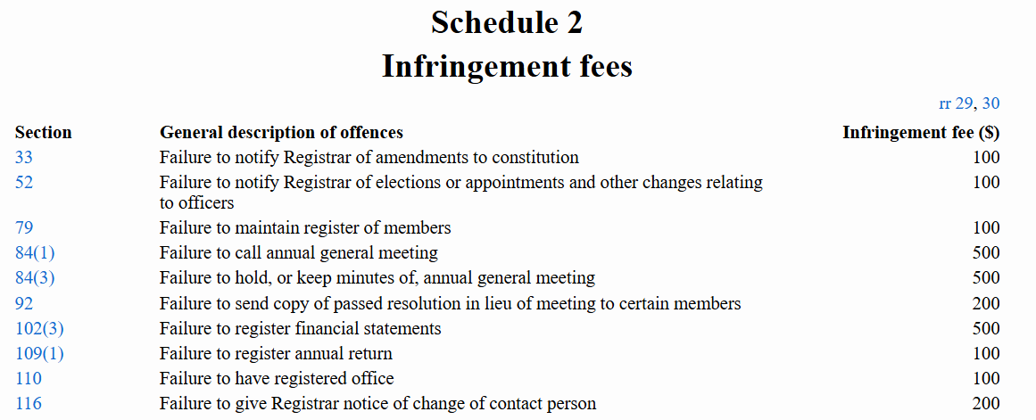
Penalties under IS Regulations 2023

Slide 6
The Role of the Board
Institute of Directors
Determining purpose - strategic mindset
Governance culture - values, tone
Holding to account – reporting, risk
Statutory / regulatory compliance – rigour
See ‘The Four Pillars of Good Governance’ IoD
Community Governance Aotearoa
Promotes a pipeline of diverse leaders
Provides tangible support…
See the ‘Good Governance Code’ Comm Gov Aotearoa
Notes:
6
6

Slide 7
Governance isn’t a doddle
Responsibilities and obligations are serious and substantive
Attendance at meetings isn’t optional
Significant decisions require rigorous processes and record keeping
Statutory compliance is not optional … there are consequences
Compliance with your Constitution and RI Rules is not optional … consequences (e.g. ISA22 Regulations)
Notes:
7
7

Slide 8
Governance risks… some examples
Ignorance is no defence
“I’m just a figurehead, I don’t have to do anything… We’ve always done it this way”
“Well, I didn’t/don’t know that…”
“Don’t need training, done it all before”
Insurance
RI Rule - each Club must have cover and ensure that it does…
Club Constitution requires it to comply …
Insurance is provided through an NZ-wide policy organised by a Rotary Zone committee
A Club that is not insured is “failing to function” (RI rules), which can lead to closure
Abuse, harassment, or moral turpitude
RI Rule - Club must terminate membership, if not, DG/RI can terminate the member
Notes:
8
8

Slide 9
The role of the Secretary…
The Secretary and…
the Board
the Club
the District
RI & RISPPO (Regional Office)
The Secretary is often the Officer who knows most about the Club and its members
Notes:
9
9

Slide 10
Officers, know your Constitution… and the Act
The new NZ Standard Rotary Club Constitution:
Now the Constitution for every NZ Rotary Club – familiarise yourself with it and refer to it…
Club Bylaws…
Under the Act:
Officers must complete template ISA22-CCO consenting to be an Officer
As an Officer you must:
  Act in good faith and in the best interests of the society
  Exercise powers for proper purposes only
  Comply with the Act and your society’s constitution
  Exercise reasonable care and diligence
  Not create a substantial risk of serious loss to creditors
  Not incur an obligation the officer doesn’t reasonably believe the society can perform
NB: under the Act a society’s members whose positions affords them significant influence over the management of the society may be regarded as ‘officers’
Notes:
10
10

Slide 11

The Role of the Secretary – as a member of the Board
Governance culture
https://www.centreforsocialimpact.org.nz/media/1630/200806-singlepage_nap-for-comunity-governance_nocropmarks-final.pdf
Critical
The Board works as a team
Representing and serving the purposes of the Club and the interests of all its members, not a select or dominant few
Notes:
11
11

Slide 12
The role of the Secretary…
ClubRunner (not My Rotary!) – the Club’s membership & officer ‘register’ required under the Act… Club Members, Executives, Club details… and all changes ($$$ penalties) – use the District account (accessible via the District website)
District Directory – Clubs as Members and their Executives; Club membership numbers; registration… and all changes
Club Calendar - Board Meetings, AGM, Changeover etc
Club Minutes, records and archives – including Officers’ Register of Interests, committee/project/events records, RI Foundation Points (you’ll need to have My Rotary ‘sign in’ for this) etc
  Q: who in your Club is responsible and accountable for the Club Bulletin?
Correspondence – receiving and responding to internal and external…
The RC of X Charitable Trust – not the responsibility of the Club Secretary but you must ensure that Club Minutes are distinct from Trust Minutes… this is too often a ‘governance risk’ because of poor practice (Trustees… no ‘clear blue water’… accounts!)
And underpinning it all, a good/effective/conscientious Board Secretary will advise the Board and individual Officers, direct its attention to matters of import, and hold the Board to account be it for poor governance practices through to not addressing pertinent matters
Notes:
12
12

Slide 13
The role of the Secretary
Continuity from one Rotary year to the next – particularly relevant now given the requirements of the Act (below…)
Prior to end of year and Changeover…
Members’ profiles and changes of Status…
Incorporated Societies Act 2022 - fully implemented 5 April 2026 with all 9940 Clubs re-registered
  Secretary - the nominated ‘Contact Person’ for the IS Registrar
  Timely notification to the Registrar of changes ($$$ penalties – slide 5)
  Use your Club Constitution as your guidebook, and your Bylaws
Notes:
13
13

Slide 14
Treasurer’s Role
Managing & reporting on finances. Read your new 2026 Club Constitution.
Change signing authorities at the bank – a nightmare! Don’t remove signatories until new ones confirmed.
Budget discussion with Incoming President – should start in May
Finances AND member (esp for meals) accounts – Xero, other packages, spreadsheet
GST – you must register if your turnover is >$60k
Annual Accounts – new Tier format. Most clubs will be eligible for Tier 4, but, using Xero, Tier 3 (accrual) is often easier.
Transfer fund-raising profit to Trust before year end – accrual not acceptable for tax offsets
Have the accounts reviewed - for transparency and keeping members ‘happy’
Notes:
14
14

Slide 15
Treasurer’s Role – Dues etc
Payments through the year - RI & RDU - semi annually Jan/July
- District - annually July/Aug
Invoicing is based on Club numbers in ClubRunner, so get them correct
RI now has an NZD bank account 30-2904-0414977-061
Per Member Costs for 2027/28
The RI Dues have been set at USD 85.50pa = 147.40 (@FX 0.58) No GST
RDU cost pa = 39.00 No GST
9940 District Levy (subject to confirmation of budget) = 27.60 (= 24.00 + GST)
Total RI, RDU & 9940 District = 214.00 (incl GST on 9940 levy)
Payable approx $120.80 (incl GST of $2.40) July/Aug 2026 and $93.20 (no GST) in Jan 2027
RI have confirmed that the RI Dues will rise by USD3.50 in each of the next 2 years 2027/28 & 2028/29
In addition, clubs will be required to pay for their insurance. More in following slides…

Slide 16
Treasurer’s Role
AGM – Nov, but must be by Dec so you can meet requirements of the Act/Regulator
Weekly meetings
member accounting/statements – Xero does this well
make payments with appropriate authorities
regular reporting to the Board
Changeover – ensure costs allocated to correct year. It is possible to have two in a financial year.
Tax certificates can be issued to members (and others) for donations to the Trust (generally made through the Club and must be voluntary). The Club can issue them on behalf of the Trust as Xero can hold that info. There is a required format for such tax certificates.

Slide 17
Treasurer’s Role – 9940 actions
9940 Levy: As per the proposed 2026/27 budget, District 9940 has determined to use reserves of around $34000 to meet a substantial part of the coming year’s expenses.
We anticipate doing so again next year (2027/28) as we move into re-districting. After all, the reserves were established from 9940 Clubs, and we want to give some of these funds back to 9940 Clubs.
What will happen in the 28/29 year in the new District is moot, but there will almost certainly be an increase in District dues back to last year’s level ($45 + GST)+/- (allowing for insurance to be paid in addition).

Slide 18
Treasurer’s Role - Insurance
Starting as at 1 Jan 2026, the insurance renewal is devolved to Club level - whereas it used to be paid on behalf of Clubs by District.
Each Club needs to complete a survey/questionnaire - you will have already been asked to do this.
If you don’t complete the survey, your Club won't be covered.
If you haven’t got insurance, you can't remain as a Rotary Club.
Coverage is for liability, Directors and Officers, Statutory and Trustees

Slide 19
Treasurer’s Role - Insurance
District 9940 took money from Clubs in the last Levy to cover the budgeted insurance cost. We passed this money to ZIPC , together with a further amount from reserves so Clubs should not have any ‘cost’ for the 2026 insurance liability coverage.
District 9940 has also determined it will meet Clubs’ cost of the new Material Damage cover provided through what is basically a ‘self insured’ fund
The net effect is 9940 Clubs will not have any ‘extra’ insurance costs for the current year. The net impost on reserves is expected to be around $10000 this year.
Again, 9940 expects to pay at least a portion of the 2027 insurance costs from reserves also.
What happens in subsequent years will be a decision for the new enlarged district board, but our expectation is that as from then, clubs will have to pay the full insurance premiums, whatever they are set at.
Each club should take this into account in setting member subscriptions and perhaps retain some funds from the 27/28 year to meet some of those future expected costs.

Slide 20
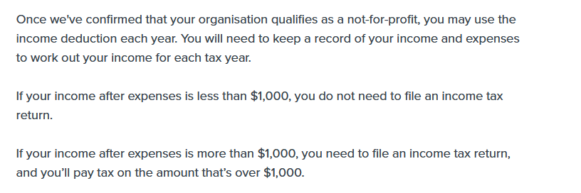
Treasurer’s Role – Income Tax
In previous presentations, I have been advising clubs a tax return was to be made by all Clubs, irrespective of whether tax was payable or not.
I learnt very recently that this is NOT the case.
IRD says at https://www.ird.govt.nz/roles/not-for-profits-and-charities/setting-up/tax-exemptions-and-deductions-for-nfps/income-tax/income-deduction

Slide 21
Treasurer’s Role - IRD
Requirements of the Inland Revenue Department – Clubs
If the Club is registered with IRD and is designated as a Not-for-Profit organisation, the Club gets a $1,000 offset against taxable income.
If the taxable income is less than $1000, the Club does not have to lodge a tax return
‘Losses’ can be carried forward
In the last 10 years or so, some Clubs have received significant bills for incorrectly returned GST and income tax
If in difficulty, District Treasurer can help – has helped some Clubs and other expertise is available

Slide 22
Treasurer’s Role – Payments Overseas
Payments/donations to go Overseas
The standard Rotary Charitable Trust Deed does not allow payments to be made outside NZ.
No such constraint is put on clubs.
So make overseas payments to overseas (using Rotary Clubs wherever possible) through RNZWCS* or RNZCCT**
Charitable Trusts paying directly overseas may put tax free status of the Trust at risk
*Rotary New Zealand World Charitable Service
**Rotary New Zealand Clubs Charitable Trust

Slide 23
Fundraising - The MONEY flow
Donate all Club Profits to the Trust
BEFORE the end of the year
CLUB
runs the Projects
Provides the manpower
TRUST looks after the money
Charitable Causes and Activities
DONATES
the profits
to the TRUST
Trust makes Donations
Below line only for very large fundraising projects
DONATES the profits
to the TRUST
COMPANY runs projects

Slide 24
Governance of your Rotary Club
by the Board and its Officers
on behalf of your members
Reflections?
Questions?
Follow-up with your Boards
We are available to discuss and support you with your issues and queries
Helen Algar - helen@algar.co.nz Adrian Gregory - adrian@helix4consult.co.nz
Graham Evans - graham@breakerbay.co.nz Linda Wellington - lindaw@waterford.co.nzp

