Slide 1
What Are We Really Offering Our Communities?
Shifting the Membership Mindset

Slide 2
What is causing Rotary’s membership crisis?
Retention problems
(too many people leaving)
Recruitment problems
(not enough people joining)
EXTERNAL
NON-CLUB RELATED
ISSUES
(uncontrollables)
INTERNAL
CLUB RELATED
ISSUES
(controllables)
PEOPLE DON’T
LIKE
WHAT WE’RE OFFERING
PEOPLE DON’T
KNOW
WHAT WE’RE OFFERING
WE CAN’T DO ANYTHING ABOUT THIS
PRODUCT
PROBLEMS
PRODUCT
PROBLEMS
PROMOTION
PROBLEMS
Notes:
What is causing Rotary’s membership crisis? My first objective today is to change your perspective, so you focus on causes, not symptoms.
We’ve all been conditioned to see this in terms of Retention problems (too many people leaving), and recruitment problems (not enough people joining). We’ve even heard quotes from Rotary leaders suggesting, “We don’t have a recruitment problem, we have a retention problem.” Take my word for it, we have both.
There are two contributors to our retention issues, and they are EXTERNAL, NON- CLUB RELATED ISSUES, or what I call the “uncontrollables”. These include health concerns, death, relocation, family trauma, work stress, etc.
No matter how well a club is travelling, there is nothing we can do about these external factors.
Then we have INTERNAL, CLUB-RELATED ISSUES, or what I call the “controllables”, such as poor leadership or direction, conflict and members feeling unappreciated.
I categorise these all as problems with our PRODUCT.
Let’s switch to the other side of the flowchart and delve into our RECRUITMENT problems. These can also be divided into two basic issues.
People don’t LIKE what we’re offering, or people don’t KNOW what we’re offering.
If people don’t like what we’re offering, that too is a product problem. But if people don’t know what we’re offering, that’s what I call a PROMOTION problem.

Slide 3
What is causing Rotary’s membership crisis?
Retention problems
(too many people leaving)
Recruitment problems
(not enough people joining)
EXTERNAL
NON-CLUB RELATED
ISSUES
(uncontrollables)
INTERNAL
CLUB RELATED
ISSUES
(controllables)
PEOPLE DON’T
LIKE
WHAT WE’RE OFFERING
PEOPLE DON’T
KNOW
WHAT WE’RE OFFERING
WE CAN’T DO ANYTHING ABOUT THIS
PRODUCT
PROBLEMS
PROMOTION
PROBLEMS
Notes:
As you can see, there are more arrows pointing to PRODUCT problems than anywhere else.
So, this is where I’m looking to change your mindset.
Instead of looking at our membership challenges from a retention and recruitment perspective, I want you to start looking at these challenges from a product and promotion mindset. Recruitment and retention are the SYMPTOMS. Product and promotion problems are the CAUSE.

Slide 4

PRODUCT
PROMOTION
RETENTION
RECRUITMENT
Notes:
Another way of looking at this is that recruitment and retention issues are DOWNSTREAM from product and promotion issues.
Product issues are at the top of the stream. There’s no use in promoting a product that is not fit for purpose.

Slide 5

Here’s the bottom line…
If your club has a great PRODUCT
and you PROMOTE it well,
your RECRUITMENT and RETENTION issues will DISAPPEAR!
Notes:
Simply, if the clubs in your district have a great product, and they promote it well, their recruitment and retention issues will disappear.

Slide 6
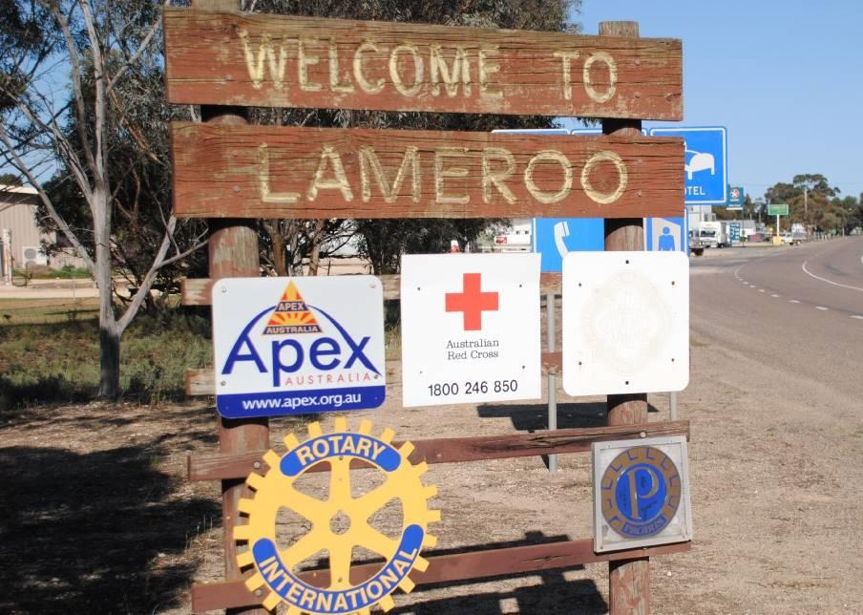
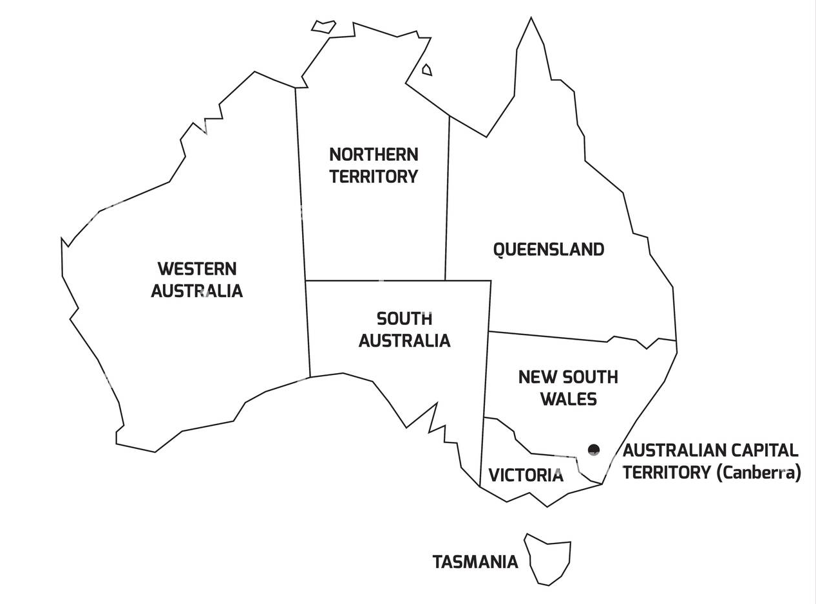
Notes:
I want to share a case study with you about the regional South Australian town of Lameroo. With a population of just under 900, Lameroo sits in South Australia’s Murray Mallee region, just over 200kms east of Adelaide, almost out to the Victorian border, and was recently named South Australia’s Agricultural Town of the Year for 2025. As you can see, at the time this photo was taken, there was a Rotary club in Lameroo.
In 2014 at a district leaders’ meeting, an Assistant Governor announced that the club would celebrate its 40th birthday, but at that celebration the club would also be handing in its charter. The club had single digit membership for many years, with the youngest members in their late 70s. The district leaders at the time trotted out the typical excuses. It was a small, isolated town which supported grain farming and sheep grazing. Much of the southern half of the continent was affected by a severe drought at the time. The young people were all heading to Adelaide or interstate for tertiary education and employment opportunities. And those wise district leaders came to the only logical conclusion.

Slide 7

This community could no longer support a service club.
Notes:
This community could no longer support a service club.
Then about six months later, at a subsequent district leaders meeting, it was revealed that Lions International had gone into the town of Lameroo and started a new Lions club with 36 members.
That was quite the reality check. It then became clear that it wasn’t about a community not being able to support a service club, it was about the version of service Rotary was offering. Quite simply, the product was not Fit for Purpose.

Slide 8


We’ve lost over 100 clubs across Zone 8 in the last 3 years.
How many of those do you think were in a community that could
“no longer support a service club”?
Notes:
Across Zone 8 we’ve lost over 100 clubs in the last 3 years. What many Rotarians fail to realise is that it’s not just the one or two Rotarians in this club or that club that is causing our serious membership decline, but the 15 or 20 we lose at a time when clubs close. Our records show that when a club closes, only a small fraction of their members continue their Rotary journey elsewhere.
 So, how many of those 100 plus clubs do you think closed because their community could no longer support a service club?

Slide 9

1
What assumptions do we make about why people won’t join our club?
Which of these assumptions would survive if another service club opened tomorrow in your area and thrived?
Notes:
It’s time for our first activity, and I’d like you all to get into groups of 2 or 3 and come up with as many answers to this question as possible. What assumptions to we make about why people won’t join our club? We’re not looking for solutions here, just the assumptions. I’ll give you a few minutes.
So, I have a follow up question, and I don’t need written answers. I just want you to think about it.
 Which of these assumptions would survive if another service club opened tomorrow in your town and thrived?

Slide 10
Product is the impact we make and the way our members are involved in making it.
Promotion is how clearly and honestly we explain that impact and involvement to people outside the club.
Notes:
When we talk about the Rotary product, we’re talking about an overall value proposition — not one thing
Our Product is the impact we make and the way our members are involved in making it.
We need to be careful about the role our meetings play in our product offering. Well-run, purposeful meetings add value to the Rotary product.
Poorly run, unproductive meetings damage it
 Promotion is how clearly and honestly we explain that impact and involvement to people outside the club.

Slide 11
PRODUCT, PROMOTION or BOTH.
2
If promotion improved tomorrow, would this still exist?
Is this an impact issue, an experience issue, or both?
“People enjoy our meetings, but we struggle to attract new members.”
“People come once or twice, but don’t join.”
“Our meetings take a lot of time, and members question their value.”
“We do good things, but the community doesn’t seem to notice.”
“Members are burning out.”
Notes:
It’s time for our second activity. I’m going to provide 5 statements, and I want you to ask yourself (SILENTLY ANSWER, DON’T SHARE YET), which of these statements are related to our PRODUCT, which are related to our PROMOTION, and which are BOTH.
 1
2
3
4
5
Now I’d like you to get into your small groups and compare answers. You should also try to agree on WHY you gave those answers.
A few other things to consider about each of these statements:
If promotion improved tomorrow, would this still exist?
Is this an impact issue, an experience issue, or both?
Which statements caused disagreement?
Which was hardest to admit as a product issue?
We generally find that promotion problems don’t cause us much discomfort, but product problems can be uncomfortable, because they require us to change.
So, I have a follow up question, and I don’t need written answers. I just want you to think about it.
 Which of these assumptions would survive if another service club opened tomorrow in your town and thrived?

Slide 12

Notes:
I have a scenario for you to think about.
A capable, busy person asks: “Why should I give my time to your club?”

Slide 13
3
1. What we think our Rotary product is.
2. What a non-member probably thinks it is.
What version would you buy?
Notes:
For our third activity, I want you all to work on your own UNLESS you have another member of your club in the room. In that case, work with your fellow club member(s).
I want you to write down two short statements:
 What we think our Rotary product is
 What a non-member probably thinks it is
Rules:
Two sentences max per statement. No marketing language.
I’ll give you about 5 minutes.
…. After 5 minutes
So, you should each have two statements before you, one describing what you feel is your club’s product offering, and a second statement being an assumption as to how outsiders may view your club.
Here comes the real test.
What version would you buy?
Put yourself in the shoes of that capable, busy person who has questioned why they should give their time to your club.
Let’s have a show of hands as to who would buy the first statement.
And now the second statement.
What are we trying to achieve with this activity? We want to create a moment where leaders privately acknowledge that what they value internally may not be compelling externally.

Slide 14

4
Your most precious resource is the time your members contribute.
Where is this time going?
Notes:
Your most precious resource is the time your members contribute.
But we need to ask  Where is this time going?
Let’s do some mental arithmetic. I want you to calculate your annual meeting hours for a typical member. Just write it down.
And now I want you to calculate your annual service hours.
Which of these creates the story you tell potential members?

Slide 15

If our club is still struggling with membership next year, it will be because we failed to change our __________.
Notes:
As you head back to your clubs to prepare for the year ahead, take some time to reflect on this question. You may wish to write down your answer.
 If our club is still struggling with membership next year, it will be because we failed to change our …..

Slide 16

Communities still want service.
If they aren’t choosing Rotary, the problem isn’t the community.
Notes:
In closing, I want to leave you with this thought.
Communities still want service.
If they aren’t choosing Rotary, the problem isn’t the community.

