Slide 1
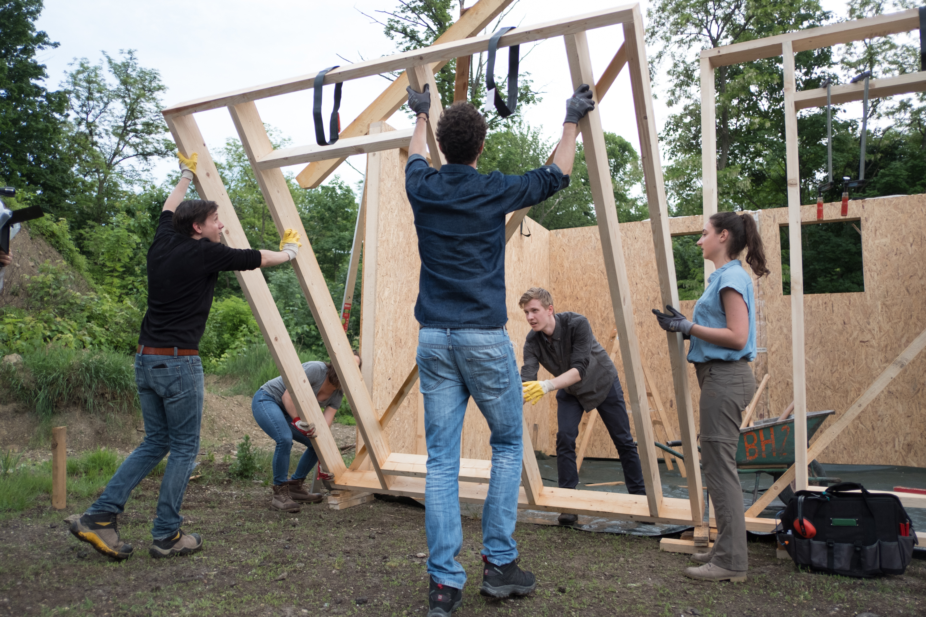

BUILDING BIGGER,
BETTER, BOLDER CLUBS
Changing how we think about membership
Barbara Mifsud – Membership Growth Officer, Rotary International Sydney Office
Notes:
Good morning, my name is Barbara Mifsud and I’m staff working at the Rotary International office in Sydney. I work as the Membership Growth Officer for our region. I provide guidance on strategy, trends, resources and best practice
I’m super excited to be here with you,. It’s such great opportunity to learn more about the great work that you and your clubs do in this region and to learn more about the strengths and challenges of your clubs in this region. But more importantly in this session I want to help you workshop ideas and strategies for building bigger, better, bolder clubs
You’ll see that the subtitle for this session is ‘changing how we think about membership’. Often when people hear the word membership – their eyes glaze over, it can have negative connotations (ah hear we go again) or it can daunting as a president elect thinking about the ‘numbers’, ‘increasing the numbers’.
Knowing the trends and our starting point is important, but instead in this session I want us to think about our end game, which is to build bigger, better, bold clubs. Membership numbers are one of the indicators of our success, but our ultimate goals to build bigger, better bolder clubs, who are responsive to both our member, prospective member and community needs.

Slide 2

Learning objectives:
Understand why building bigger, better, bolder (BBBs) clubs is important and what they look like
How we can use the RI Action Plan to build BBBs
Practical ideas and local considerations
Notes:
The learning objectives are:
Why building bigger, better, bolder clubs is important
How you can use the RI Action plan as a road map to help grow your club
Look at practical ideas for growing your club under each of the 4 strategic priorities
Explore local considerations for growing membership

Slide 3
What?
Notes:
I want you to think of a successful, vibrant club. It could be your own, another in this region, or somewhere else in the world. I want you to picture this club.
What makes this club successful? What are they doing? What do they look like?
You have post it notes in front of you. I want each of you to write at least 3 characteristics of a successful club – one per post it note. Then I want you to put them on the wall.
Solicit 4 or 5 key aspects:
Impactful, relevant service projects
Work in partnerships
Tell compelling stories and have a strong public image – in the media, social media,
Have a plan to attract new, diverse members
Make sure to retain members
Deliver value to current and prospective members
Ask what members/prospective members want and act on what they hear
Examine their club model, membership types, meeting/attendance – to suit current/prospective members
Have good governance
Welcoming environment
Work in collaboration with other clubs (in RCG)

Slide 4
Why?
Notes:
Why do you think building a bigger, better and bolder club is important? What are the benefits?
Key messages:
Create lasting impact
More people means more resources, more impact in your community
New members means fresh ideas, more relevant to the community, increasing impact
Want to ensure that Rotary is strong in its 2nd century of service – you want to ensure your legacy continues
A strong club means that the club is more visible in the community and has more influence
A vibrant club that has a good club experience keeps its members but it more easily attracts new members
Stronger club has more financial stability>resources
Secondary question: Is there a point where you should stop growing?
What about new members? What do they bring? What about longevity? And legacy?

Slide 5
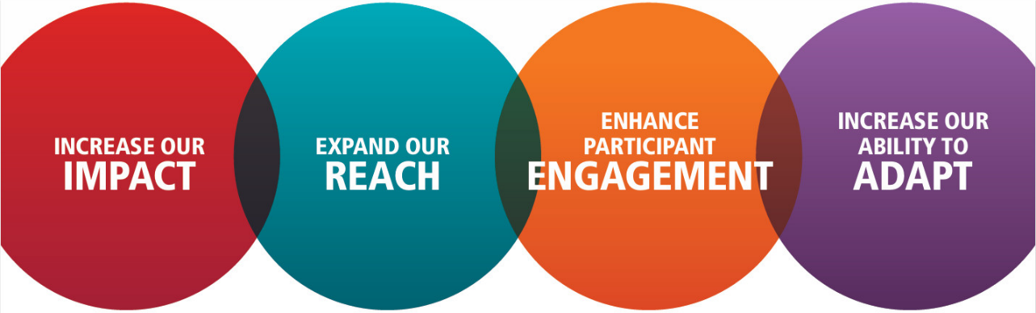
Bigger, better, bolder clubs use this roadmap:
Notes:
Most of those things that you put on the wall fit in under each of these 4 key strategic priorities of the Rotary Action plan.
How many of your are familiar with this?
Having relevant projects – fits under increasing your impact
For example – you mentioned have a strong public image – that fits under expanding your reach
Retaining members and trying to attract new ones – is enhancing participant engagement
Looking at your club model and your meeting schedule – is about adapting
Not only are they priorities for Rotary International, but these are guiding principles/priorities for becoming bigger, better and bolder.
As a club president, you will be guiding the strategic direction of your club. But how will you know if you are going in the right direction? I’d encourage you to look at everything that you do as a club or, or plan to do – through this lens. If I’m planning to do X, will it increase our impact? If I do X, does it mean I’m adapting?

Slide 6
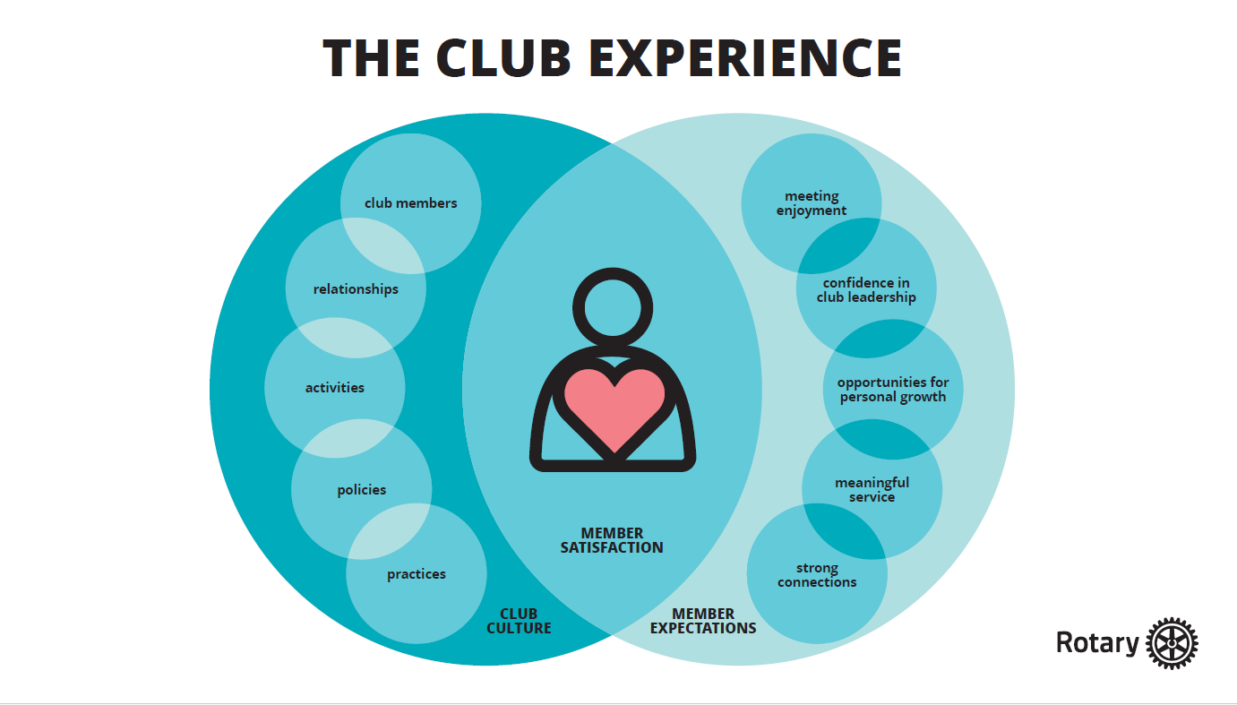
Notes:
The other lens you need to keep looking through is the ‘club experience’.
Club experience is the interplay of your club’s culture and what your members (and prospective members ) want – with the aim being member satisfaction – so that we can attract more people and retain the ones that we have.
Club culture includes things such as your members, the relationships you have, activities and projects you do, your policies and club rituals and practices.
From the research we know that members, and prospective members are looking for enjoyment, confidence in leadership, personal growth opportunities, service and make connections. Service is the number one reason people join along with making connections (ie friendship and followship).

Slide 7
Discuss:
Activity
Why is this happening?
3 strategies that may help
Notes:
Let’s work on activity to get you thinking about how to use the Rotary Action Plan to grow Rotary and make our clubs bigger, better and bolder than they are now.
We’ll look at some typical club scenarios – some that might sound familiar - that fall within each of the strategic priorities, and we are going to workshop some tactics to help build them and make our clubs bigger, better, bolder.
There are four different scenarios. Your table will be given one scenario. I would like you to work within your table on your scenario. Please elect a scribe and elect someone to report back to the group.
I’d like you to: read the scenario and then note down:
Why is this scenario happening? What are the underlying issue or issues?
Think of at least 3 strategies that may help – they can be short term, medim term or long term strategies.

Slide 8

Your club is a 40-year old club with 18 members in a regional hub. It is well organised and hosts enjoyable meetings. You run two major fundraisers each year and donate the proceeds to local charities.
The club recently attracted two younger members, but they left shortly after, citing their membership goals were not met.
Notes:
Points to elicit:
Service is the number one reason that people join, followed by friendship
From research we know that younger people will volunteer for a cause they are passionate about – community and international service/projects
People want to make a difference – and see the fruits of their labour – they don’t want to fundraise and then give the money to someone else
Ultimate goal as Rotary clubs is to help our community and create lasting impact
Assess your club offerings – are the fundraisers making an impact in the community
What are the needs of the community – community needs assessment
Ask members what their passion is and then assign them to a particular project
Incentivise passion projects for new members – also a way for us to stay relevant in the community
Partner with organisations (rather than fundraise for them)

Slide 9

Your club is a successful 50-year-old club with over 35 members. It has a signature mental health project and school book donation program. Your fortnightly meeting includes interesting guest speakers. Members enjoy the fellowship.
Very few prospective members visit your club or volunteer on projects.
Notes:
Points elicit:
Public image is important for growing your club
Have a public image plan and invest in promotional materials and activities
Elect a public image chair/committee. Work collaboratively with membership committee
Create a strong online presence
Share human-interest stories that showcase the magic of Rotary
Scale up public image efforts including prospective member events ie collaborate with RCG to host a Rotary information event or an Epic Day of Service
Use paid social media ads to recruit volunteers to projects
Take courses on the Learning Centre to learn more
Partner with other organisations on projects
Cultivate relationships with local media
Use consistent branding
Check basic tactics such as ensuring that your website and social media accounts are up to date and current, and that you post frequently

Slide 10

Rose is a prospective member who has been volunteering on your club’s health education programs.
She is a busy professional who travels for work and has a small child. Your club meets weekly, face to face, for dinner with a speaker.
Rose wants to join but is reluctant.
Notes:
Points to elicit:
Ask > listen > act
Review your club’s model of operating: can attendance requirements to club meetings be relaxed?
Could the club alternate between dinner and lunch to accommodate Priya and other members?
Look at family friendly practices – can she bring her child – to the meeting or to volunteer?
Could you offer a corporate membership? She could share membership with other colleagues and only attend when she can?
Can you offer an online option for attending meetings or committee meetings if Priya is travelling often?
If the club is reluctant to change, could they consider starting a companion club or satellite club in case there are other people that are like Priya who prefer to volunteer on cause-based projects (not meeting centred?)
What about your club model – is family friendly?
What can you do if a club is reluctant to change>

Slide 11

The average age of your club members is 65+ and membership is steadily declining. You’re located in a small farming community where many younger residents leave for cities.
Prospective members find it difficult to attend meetings or pay club dues. They are interested in gaining skills and giving back. Long serving members appear despondent.
Notes:
Points to elicit:
Have a plan for attracting and retaining members
Have a membership committee – you can’t do this by yourself
Membership survey – to see why long serving members are despondent.
Is your club reflective of your local community?
Adjust your model? Start a satellite or a companion club?
Reduce fees – help establish a Rotaract club?
From RI research young people are interested to gain skills and network – mentoring program? To retain older members and attract younger members
Also ‘enhance participant engagement’: perhaps your club sponsors an Interact club?

Slide 12
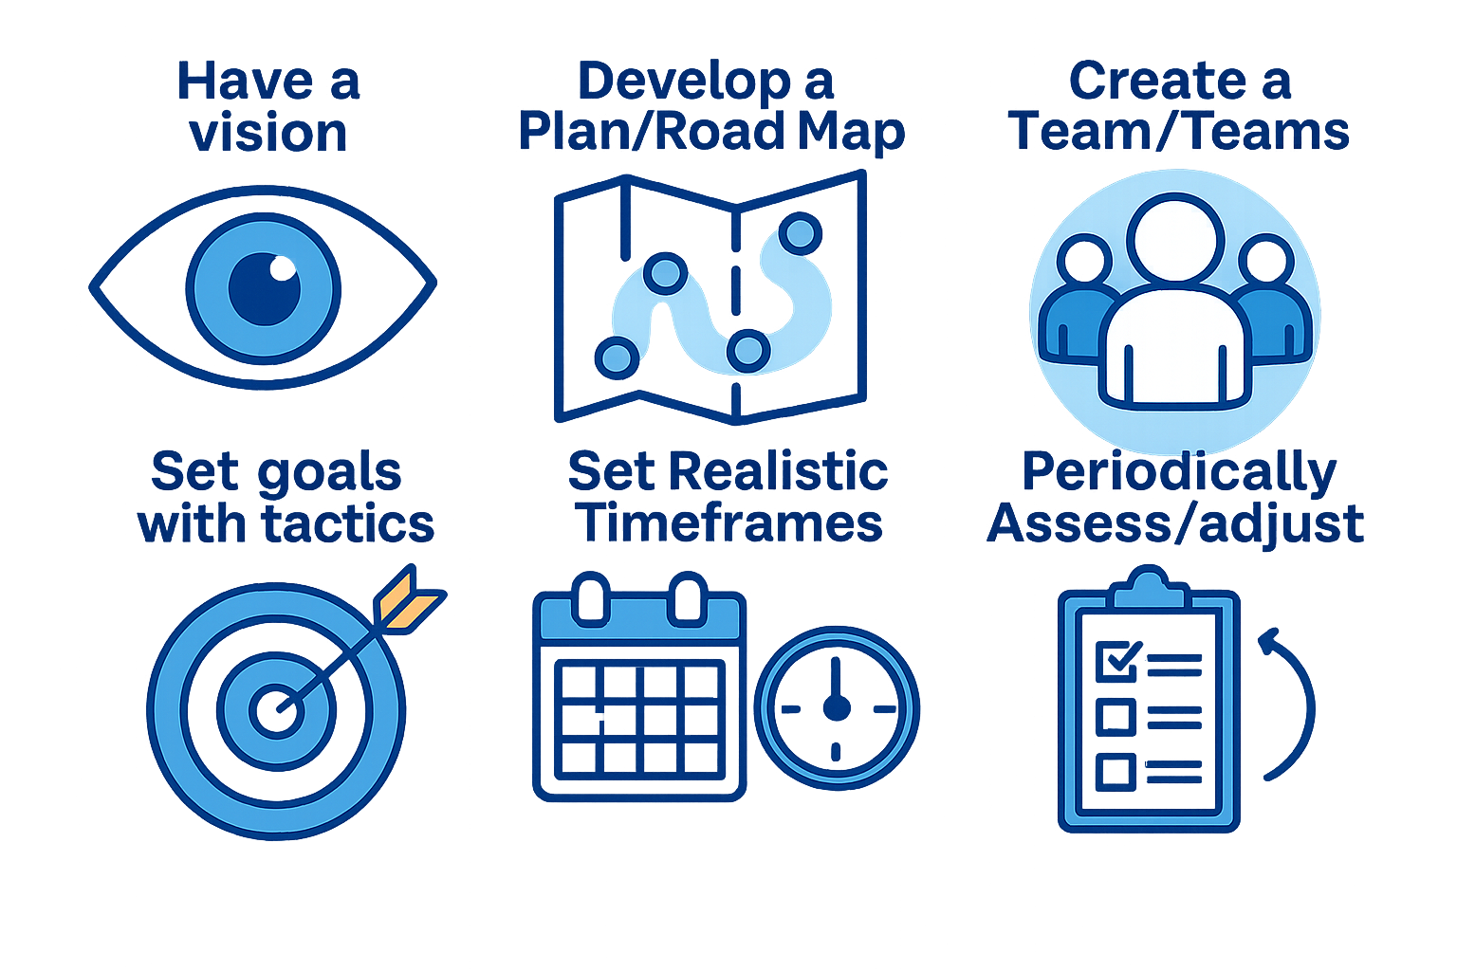
Notes:
What are the next steps for a bigger, better, bolder club?
This just doesn’t happen by itself, as a club leader you need to:
Help your club to have a vision or build on that vision – what does your club want to be known for.
Develop a plan/road map – use the Rotary Action Plan to guide you – use it as a lens, use the club experience – look at your club’s membership strategy, does it have one?
Create a team/teams – you can’t do this alone, work collaboratively, give responsibility to others
Set goals with tactics – it’s proven that those that set goals are more likely to achive goals – but also work out how you will achieve that goal
Set realistic timeframes
Periodically assess/adjust if necessary

Slide 13
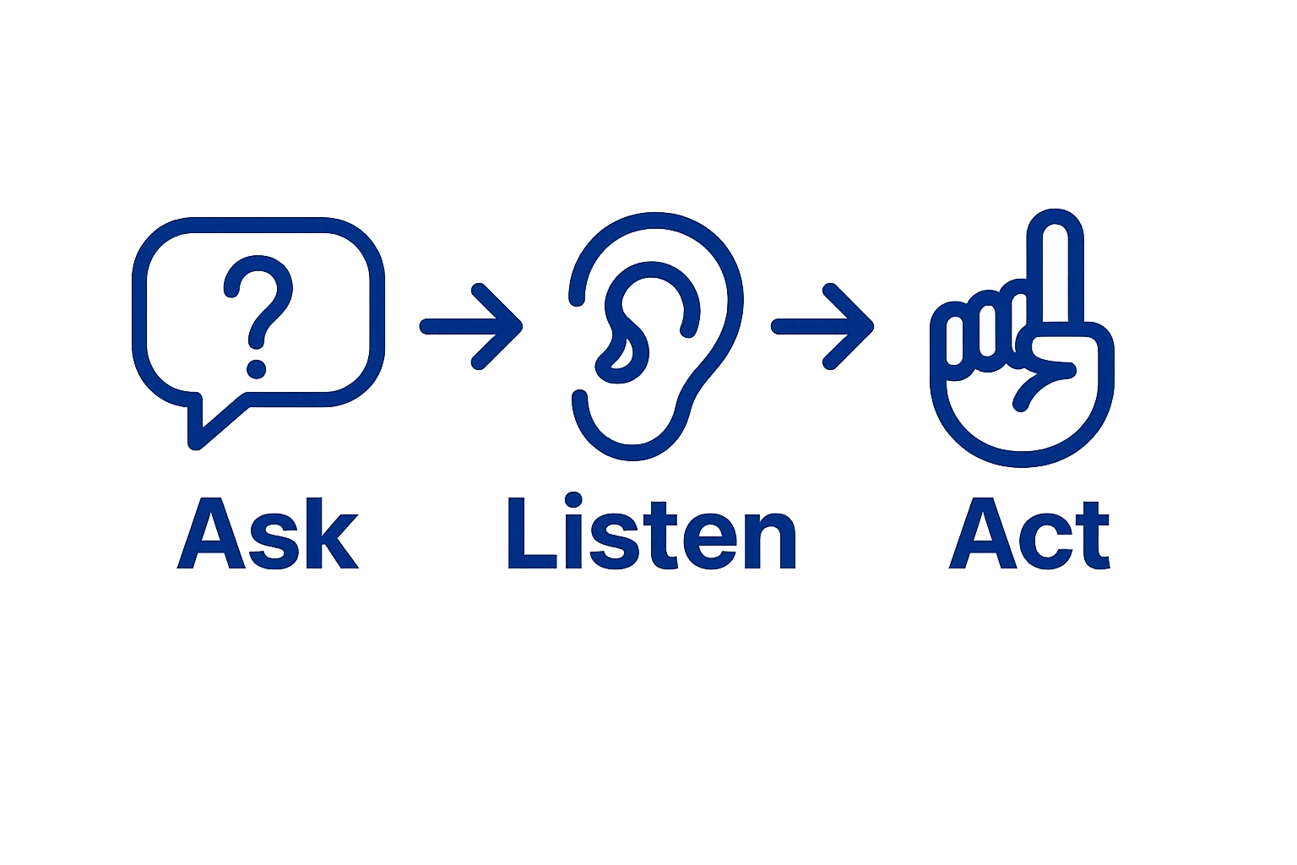
Notes:
Remember that the key to bigger, better, bolder clubs is to:
Ask – be curious, question, get feedback, – start with something such as club health, membership survey, or community assessment, feed back from non-members
Listen
Decide on your priorities, build a plan and then act on what you hear

Slide 14
Resources
My Rotary
rotary.org/membership
rotary.org/flexibility
Learning Centre
Brand Centre
Assistant governor
District membership chair and team, public image team
District governor and team
Rotary International staff
Notes:
Here are some resources for further information.
The whole range of resources on My Rotary and the membership pages.
There are also a whole range of people

Slide 15
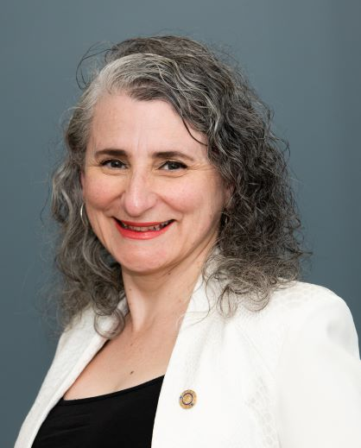
Barbara Mifsud
Membership Growth Officer
Australia, New Zealand & Pacific Islands
RI South Pacific & Philippines Office
Norwest (Sydney)
+61 2 8894 9850
barbara.mifsud@rotary.org
Notes:
Membership strategy – including attraction, engagement and retention, new club development, new member orientation,
Reports and data (so that we can make evidence based decisions on where to focus our membership efforts)
Resources (whole load of resources on the RI website)
Sharing best practice and stories

