Slide 1

Ramblings

Slide 2
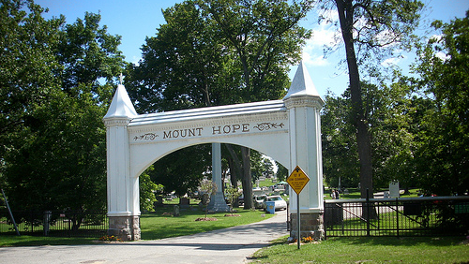

Slide 3
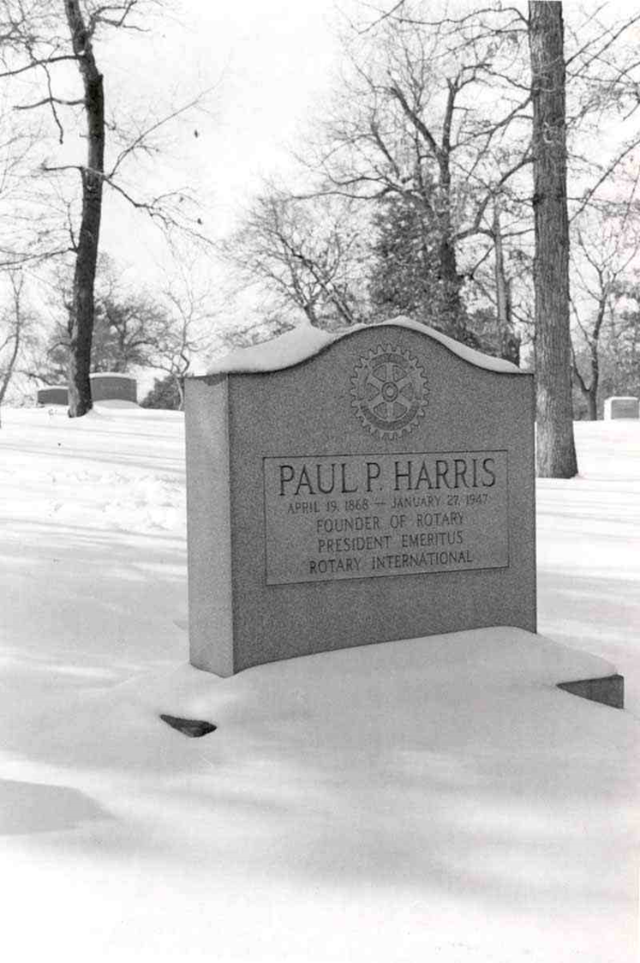
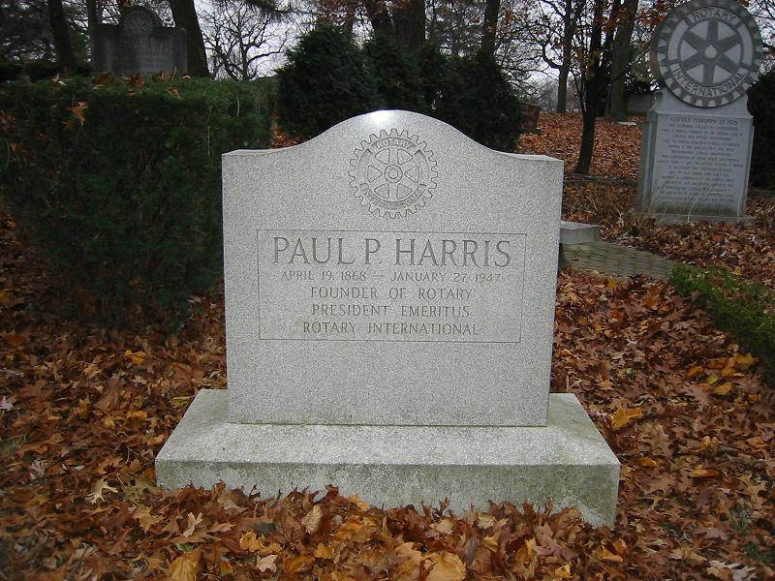

Slide 4
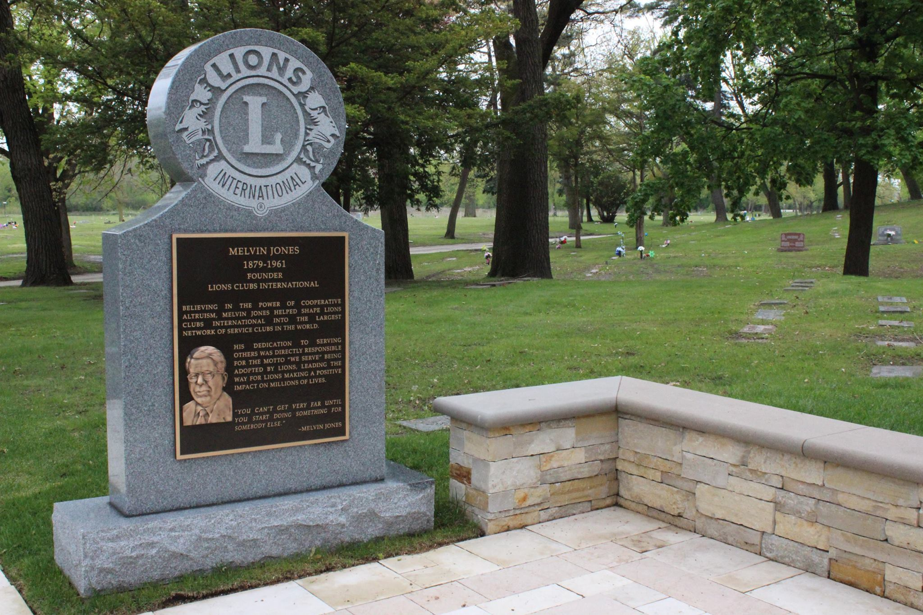


Slide 5








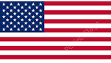

1905
1915 1917 1917 1917 1920 1921 1927
Detroit Alabama Nashville Chicago St Louis Oakland Norwich
550,000 40,000 8,000 1.35m 75,000 30,000
Chicago
1.2m

Slide 6


Founder
Year
Founded
Clubs
Members
Countries
Motto
Women
Fellowship
Paul Harris
1905
Chicago
36,673
1,170,630
200 +
Service Above Self
1987
Paul Harris Fellow
Melvin Jones
1917
Chicago
46,000
1,350,000***
200 +
We Serve
1987
Melvin Jones Fellow

Slide 7


1905
1,170,630
1962
340,000
1968
149,202

Slide 8
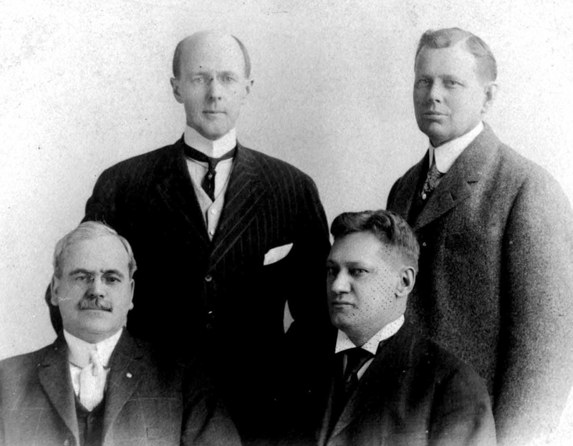
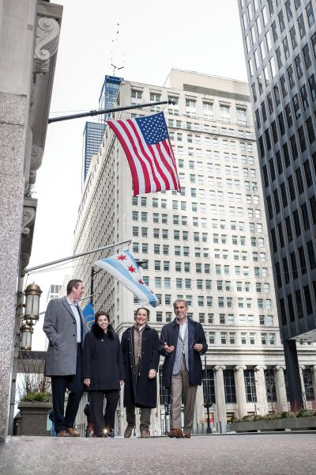


Slide 9

36,673
Notes:
Rotary should be well positioned

Slide 10
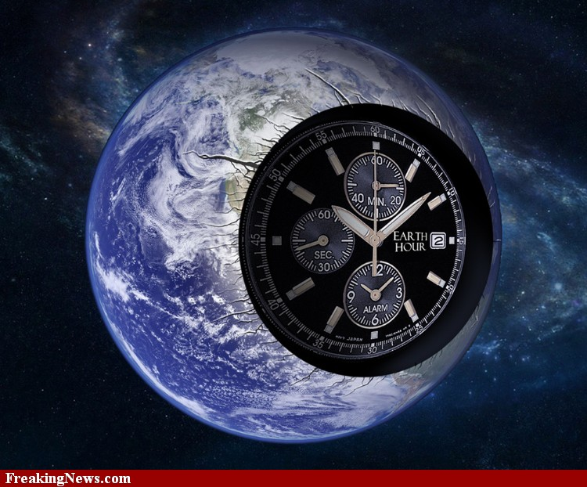
Notes:
But ‘the clock’ is ticking…..

Slide 11


Slide 12


Slide 13
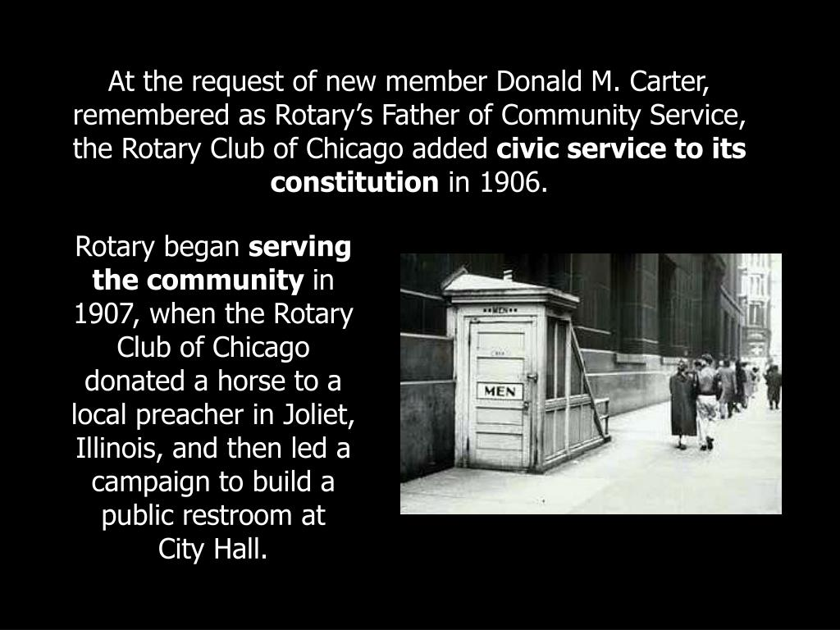


Slide 14
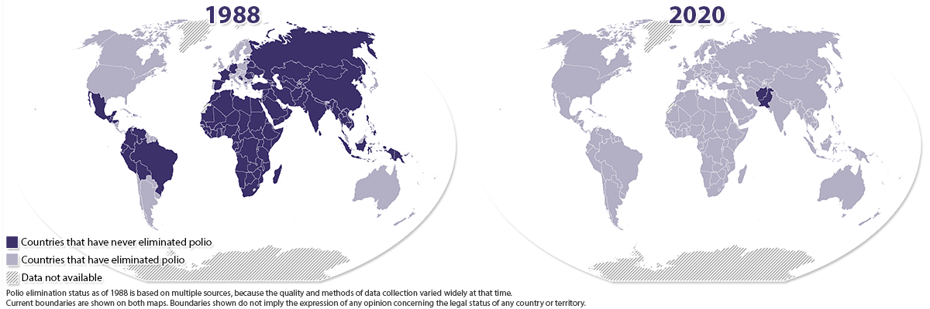

Slide 16
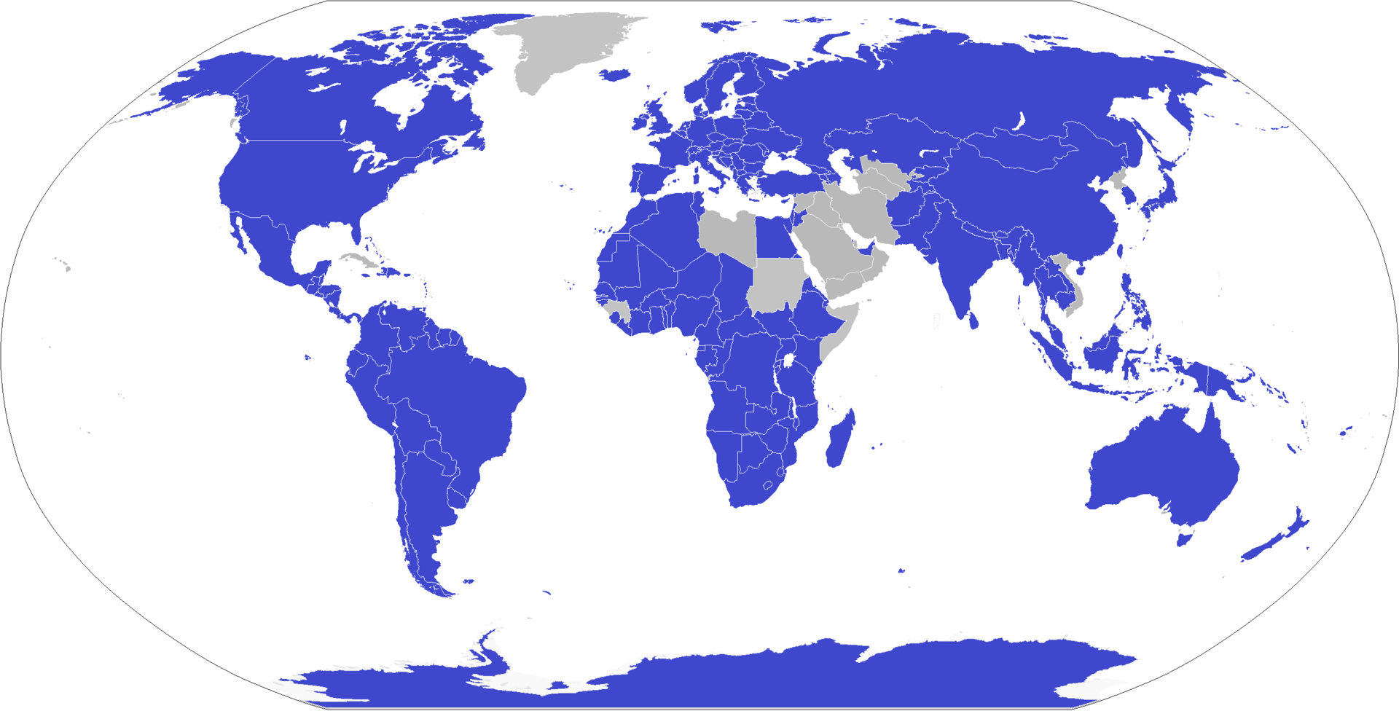

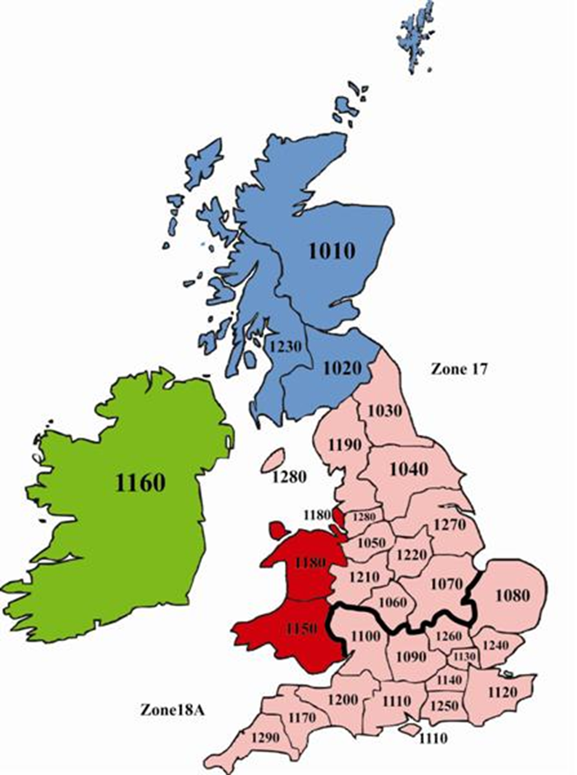
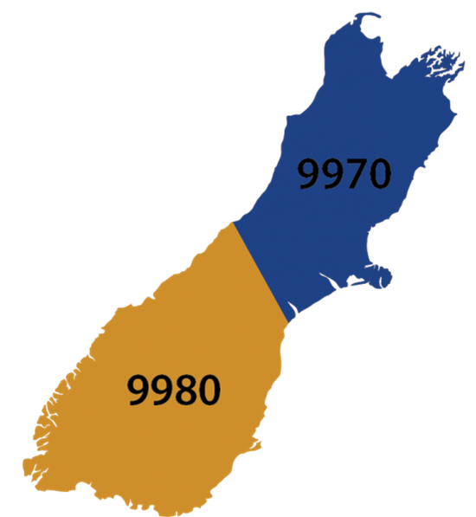
545 Districts

Slide 17

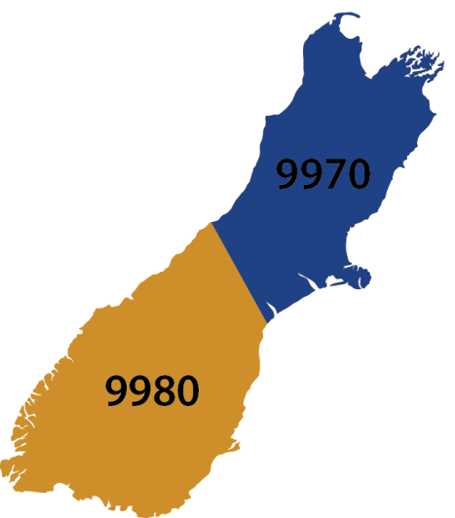
DISTRICT MEMBERSHIP LAST 5 YEARS

Slide 18
DISTRICT MEMBERSHIP LAST 5 YEARS
District 9975

Slide 19
DISTRICT MEMBERSHIP LAST 5 YEARS
District 9999

Slide 20

Notes:
To support the clubs and districts of RI in their pursuit of programs and activities that promote the Object of Rotary

Slide 21
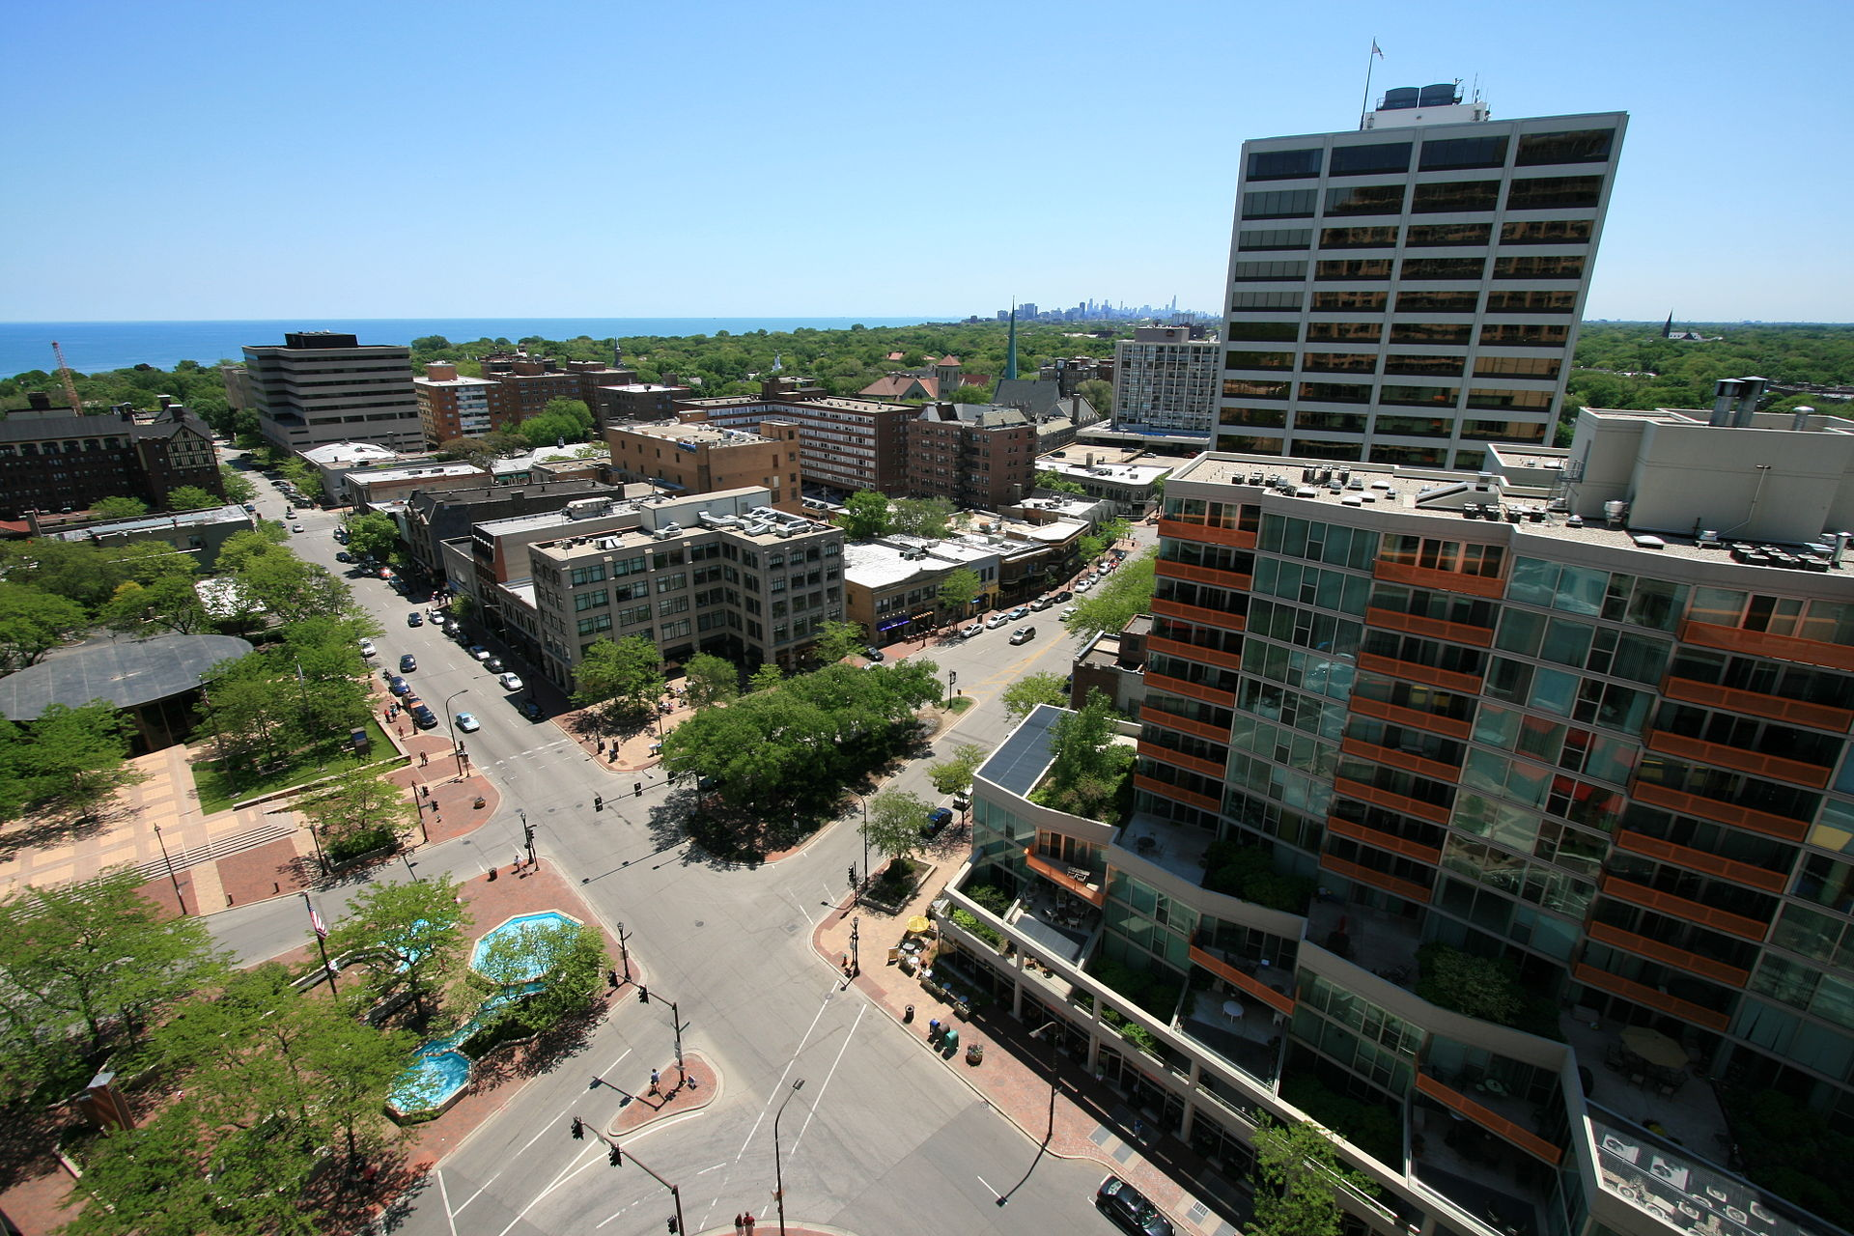
Notes:
To support the clubs and districts of RI in their pursuit of programs and activities that promote the Object of Rotary

Slide 22
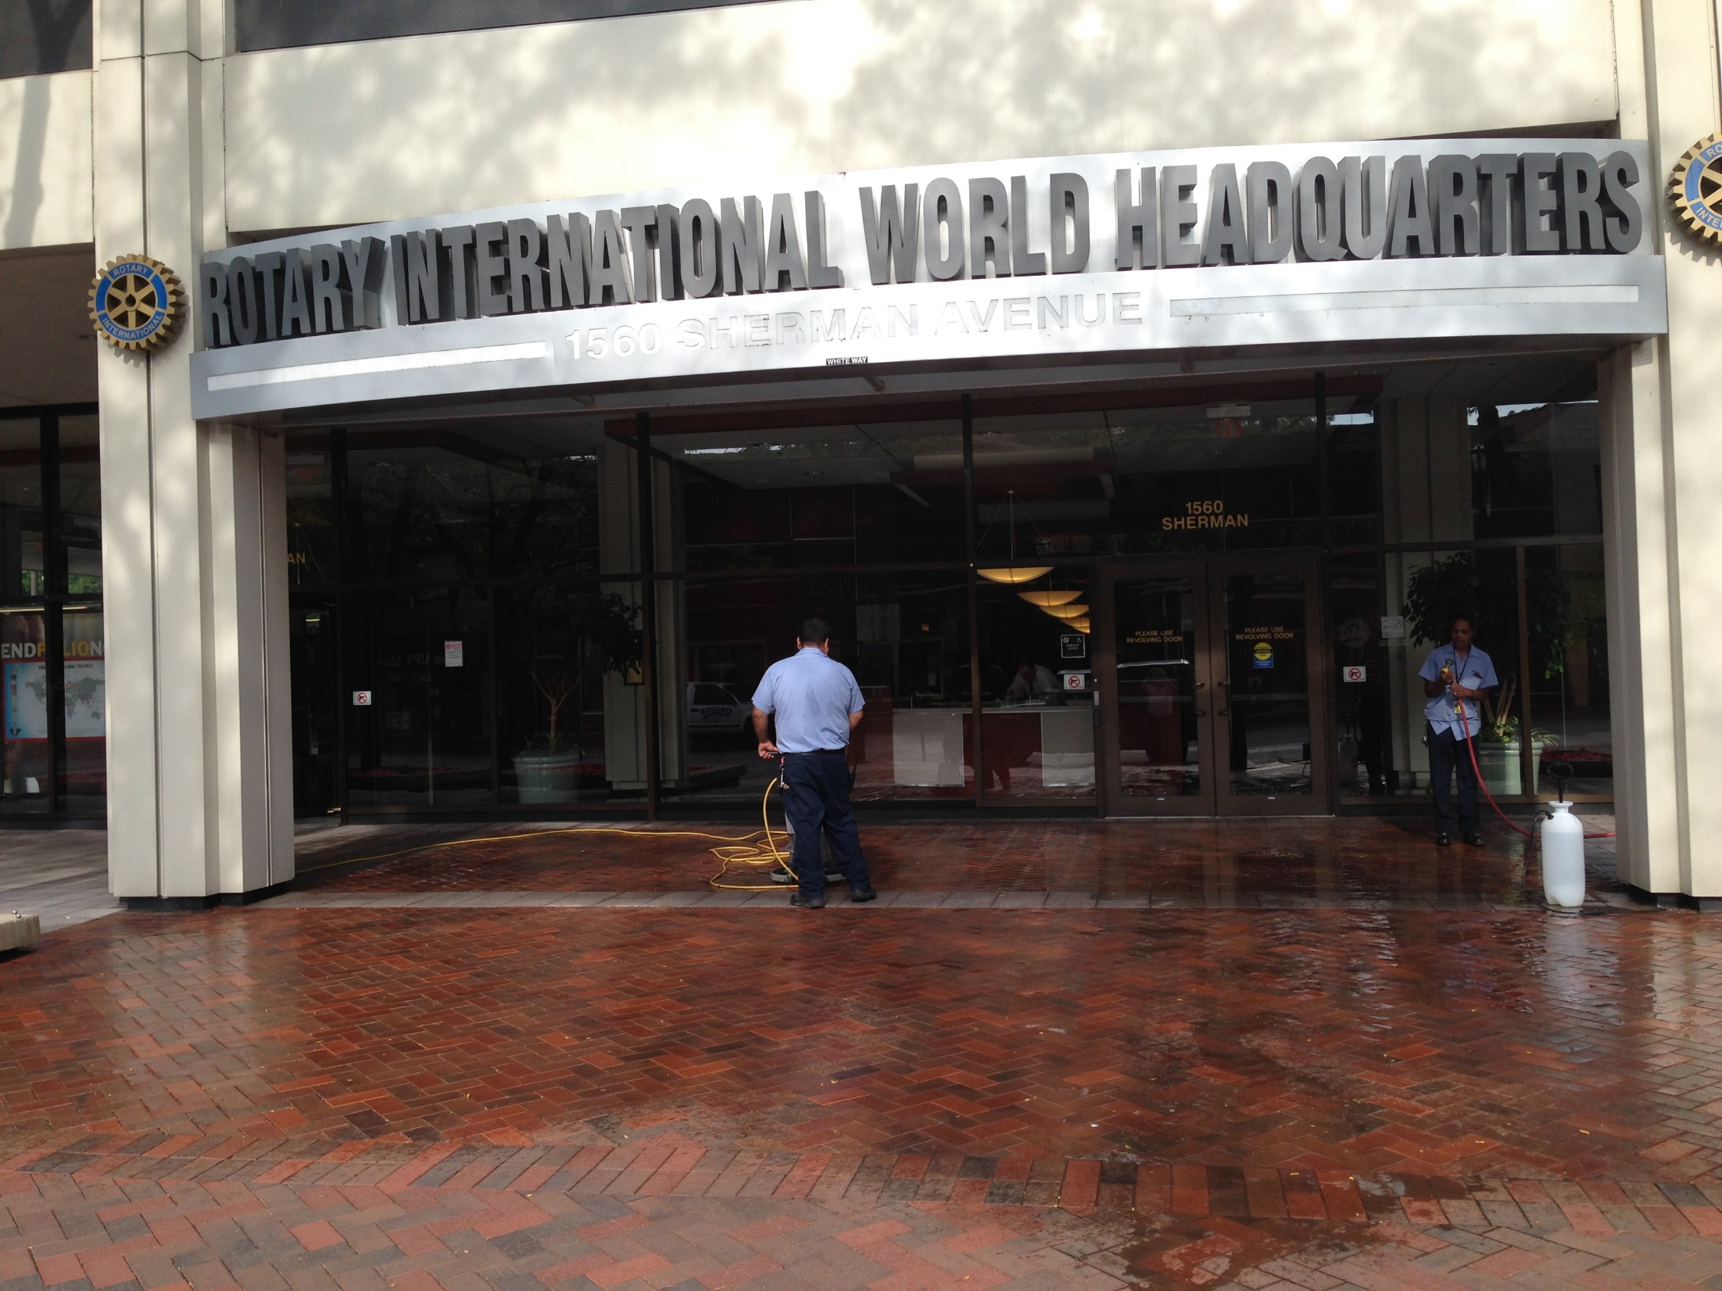
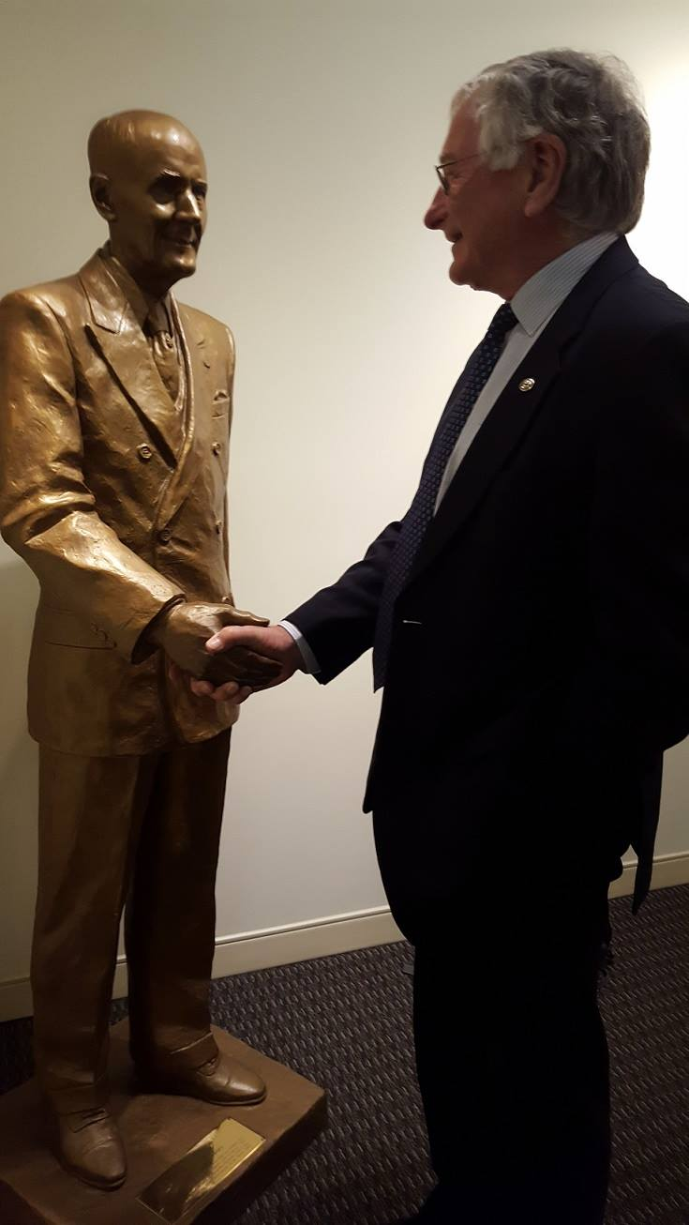
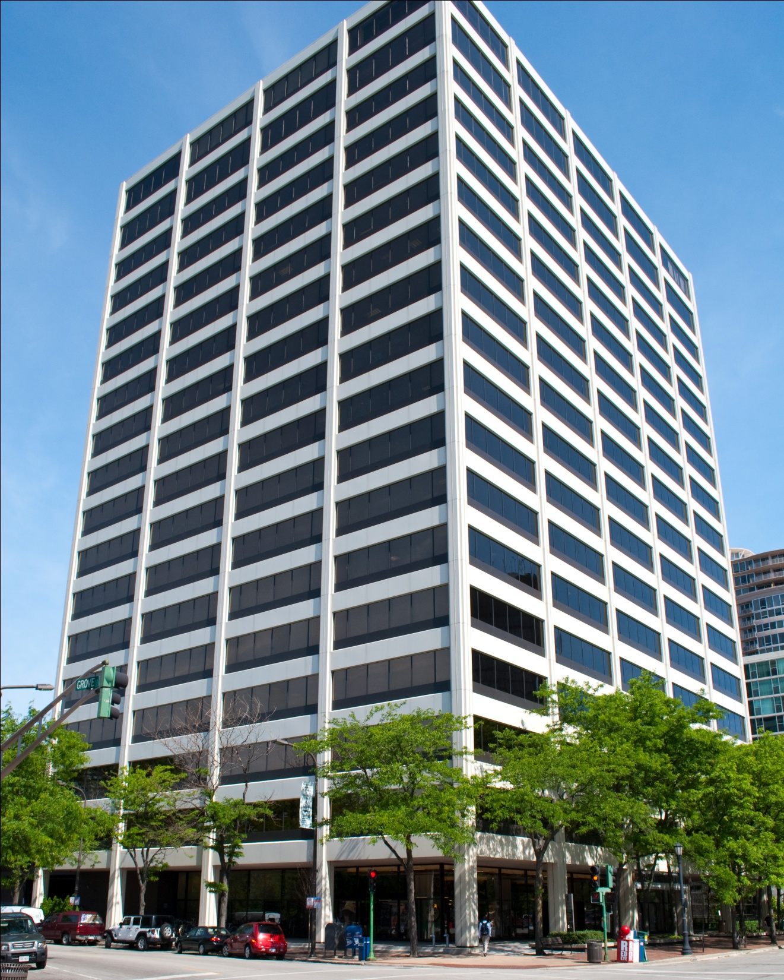
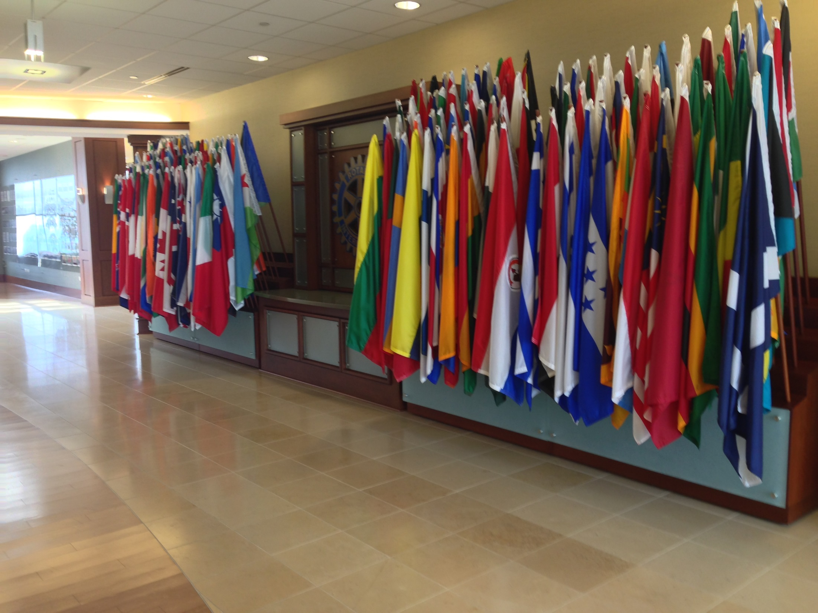
Notes:
To support the clubs and districts of RI in their pursuit of programs and activities that promote the Object of Rotary

Slide 23
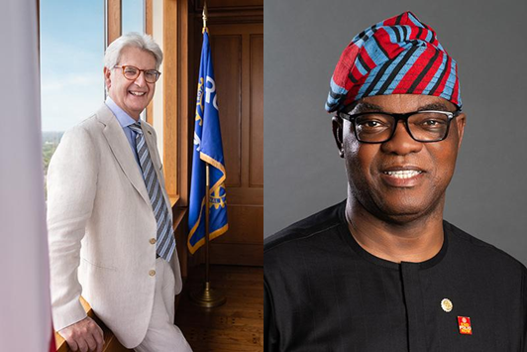


Slide 24


Slide 25


Slide 26

1926
1929

Slide 27
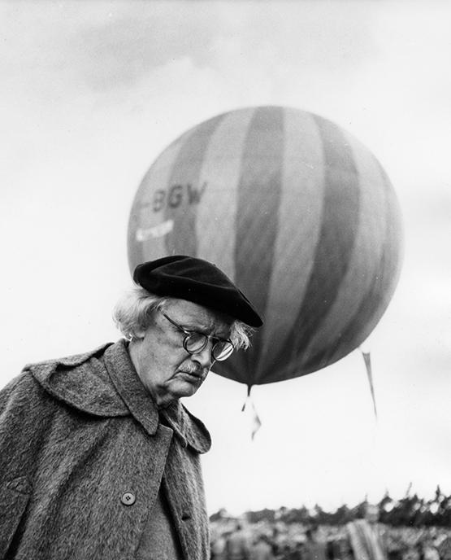
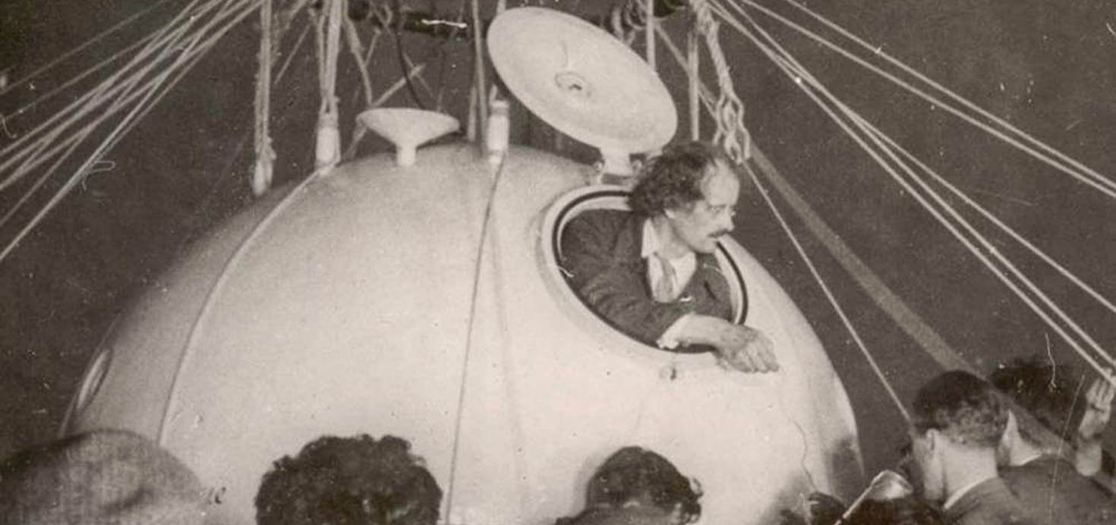
1932

Slide 28
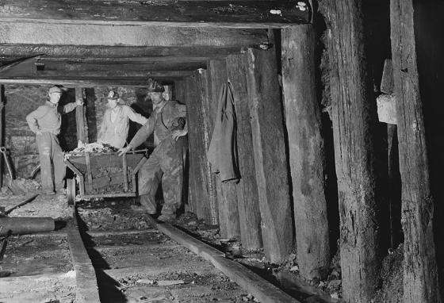
1933

Slide 29

1968

Slide 30
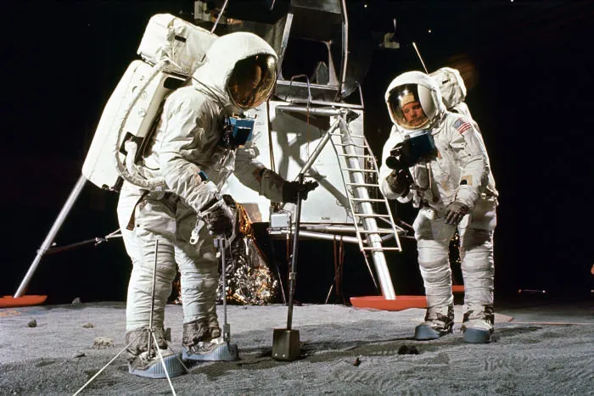
1969

Slide 31
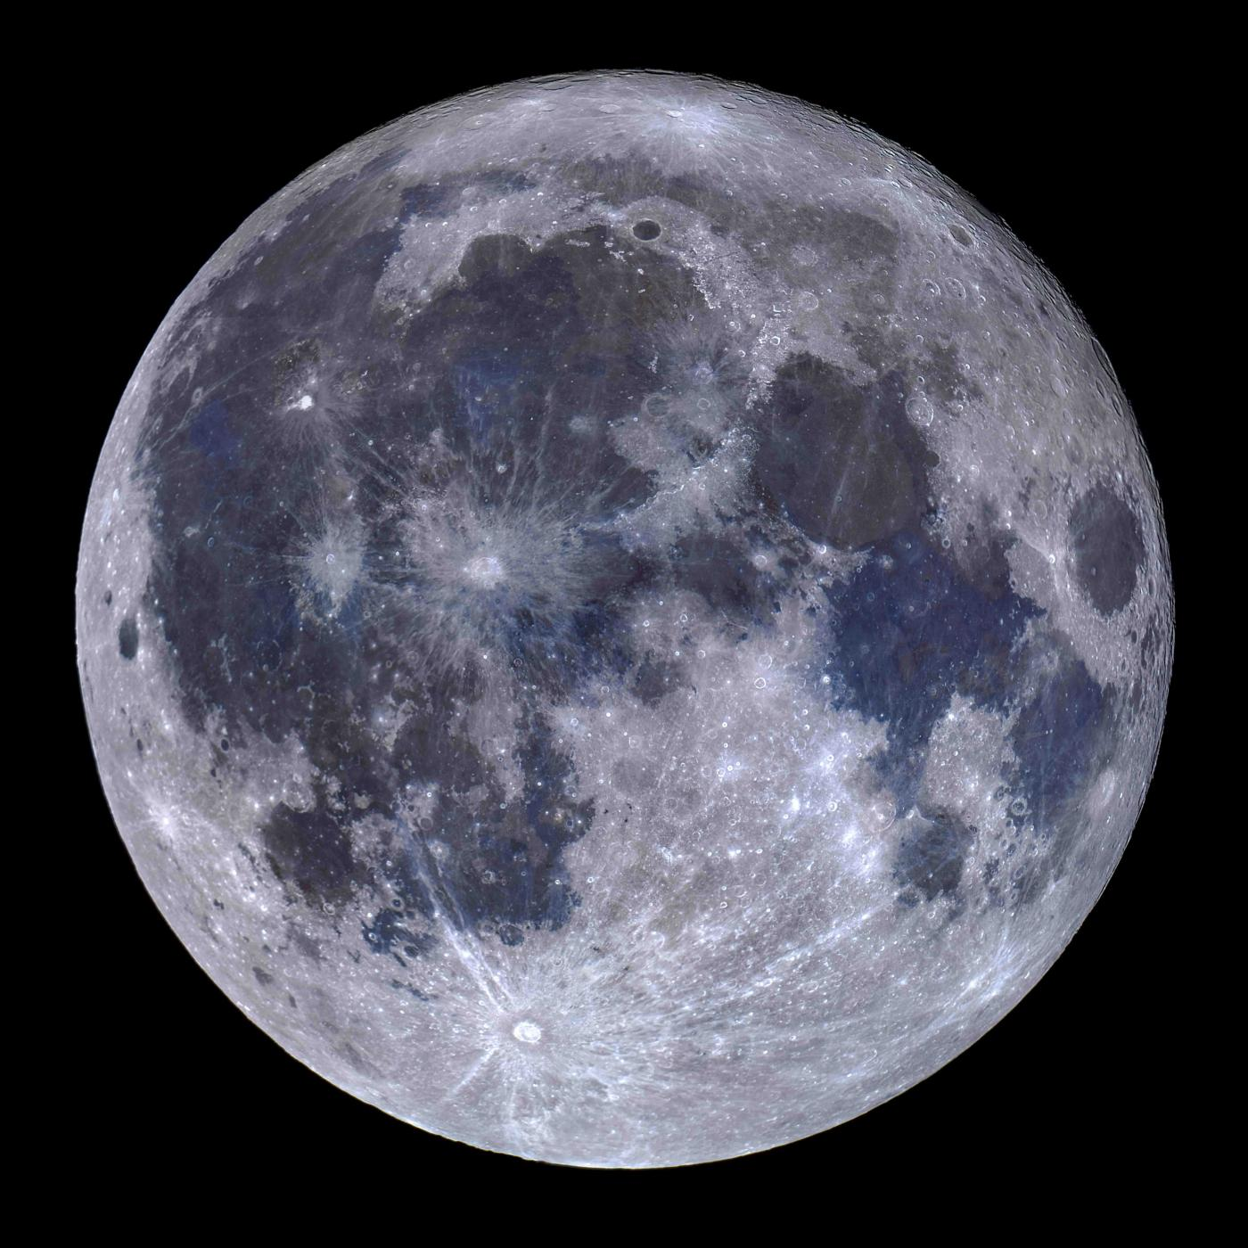
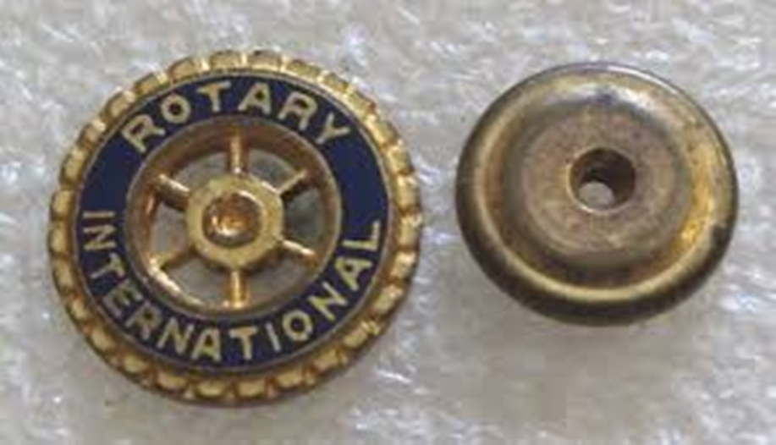

Slide 32



Slide 33
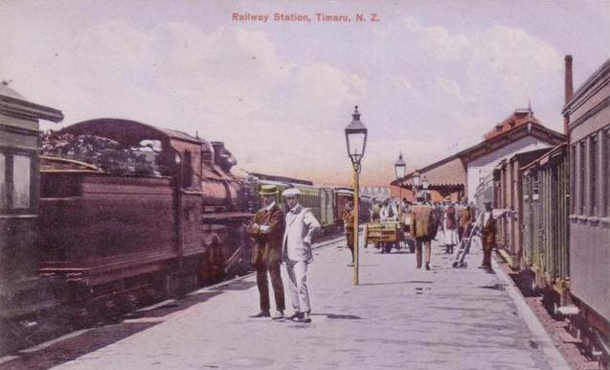

Slide 34


Slide 35
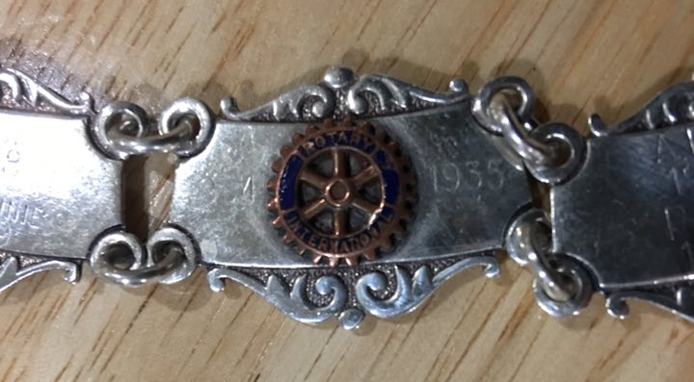

Slide 36
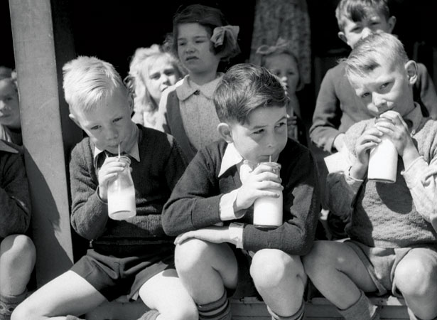
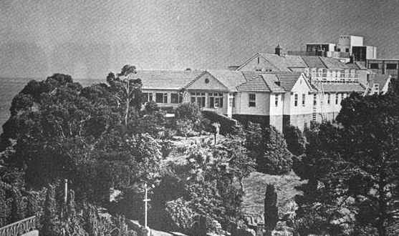

Slide 37
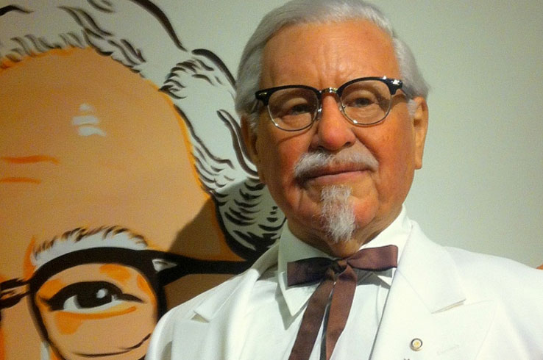
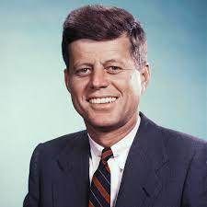
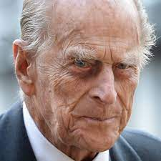
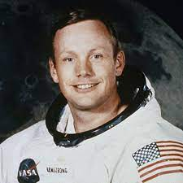
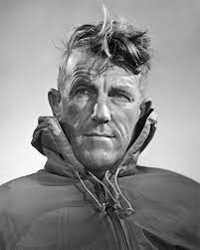
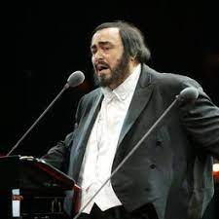
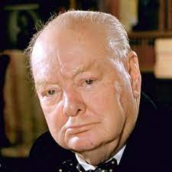
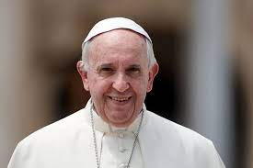
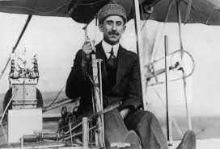
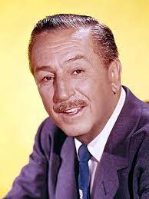
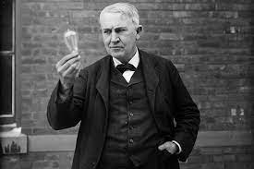
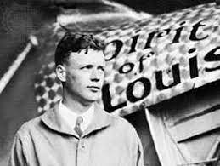

Slide 38
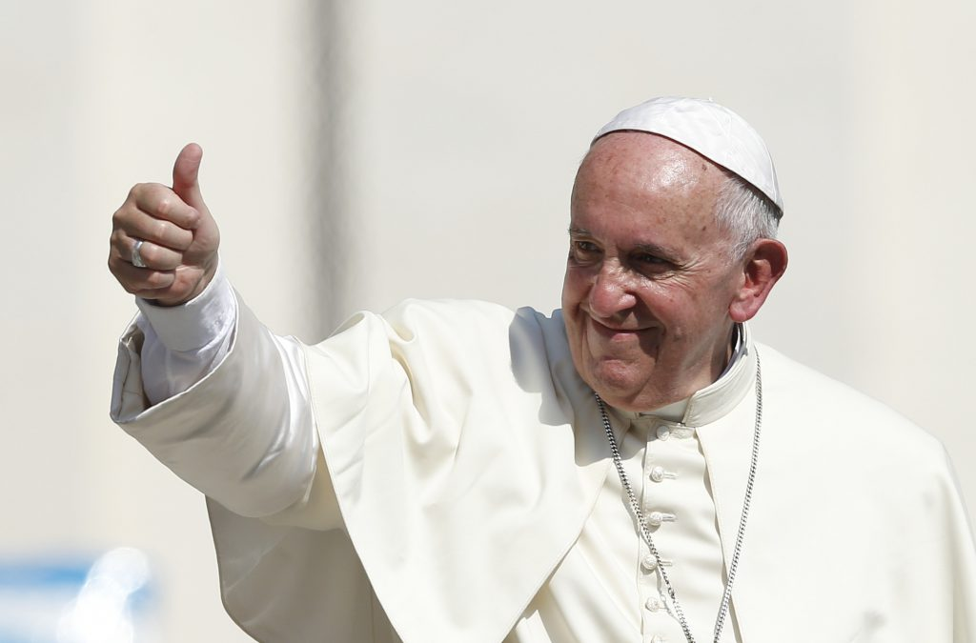

Slide 39
A search of Rotary‑affiliated sources and lists of notable Rotarians shows no record of Donald Trump being a member of any Rotary club, either as an active or honorary Rotarian.
Rotary clubs often highlight prominent political figures who are members, and U.S. Presidents who have been Rotarians—such as Carter, Reagan, and both Bushes—are well‑documented. Trump does not appear in these lists.

Slide 40
Ramblings

