Slide 1

The Rotary Foundation Presentation to
District Assembly
May 2026

Slide 2
THE ROTARY FOUNDATION
The global face of Rotary

Slide 3

You have a great team of volunteers working for you as members of
The Rotary Foundation Committee

Slide 4
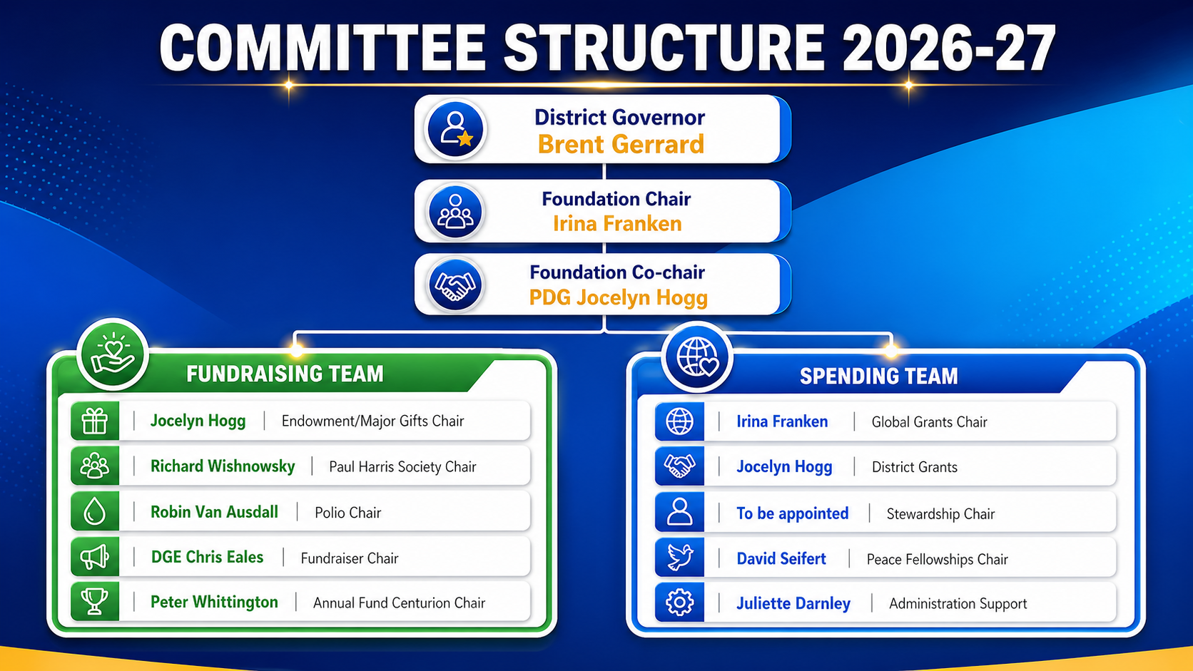

Slide 5
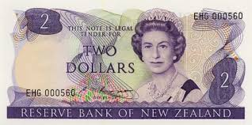
Contact: Peter Whittington
The Rotary Centurion Program is a regional giving initiative. Primarily active in Australia and New Zealand that encourages Rotary members to voluntarily donate $100 (in local currency) or more each year to The Rotary Foundation's Annual Fund.
The Commitment: We ask members to donate $100 NZD annually, which averages out to about $2 per week.

Slide 6





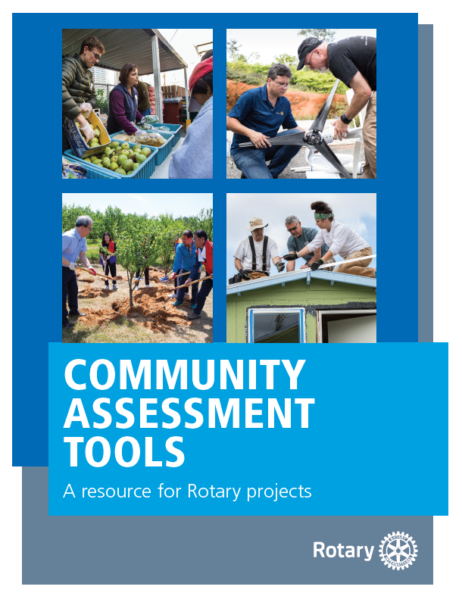

Highest Rated Charity
Rated in the top 10 in the world
Stewardship
World Fund
Match
Strict reporting
processes in place
DDF matched
The multiplier effect
Rotarian
Engagement
Sustainability
Planning and technical support
Delivering long term community outcomes
Community
Assessment
Low
Administration
Projects based on NEED, not perception
9% for Administration and Fundraising cost

Slide 7

subhead
Grant types
District grants
Global grants
Disaster response grants
Programs of scale grants
Notes:
The Rotary Foundation offers grants that support a wide variety of humanitarian projects, scholarships, and training that Rotarians are doing around the world. We have four types of grants: global grants, district grants, disaster response grants, and programs of scale grants. I’ll tell you more about each of them.

Slide 8

DISTRICT GRANTS
Small-scale, short-term
Local or international activities
Aligned with the Foundation’s mission
Single grant awarded annually
Notes:
District grants fund small-scale, short-term activities that address needs in your community and communities abroad. Each district chooses which activities it will fund with these grants. You can use district grants to fund a variety of district and club projects and activities.
You have a lot of freedom to customize your service projects. There aren’t many restrictions, as long as your district grant supports the mission of The Rotary Foundation, which is to enable Rotarians to advance world understanding, goodwill, and peace through the improvement of health, the support of education, and the alleviation of poverty. Districts must be qualified before they can administer district grants.
Districts may use up to 50 percent of their District Designated Fund to receive one district grant annually. This percentage is calculated based on the amount of DDF generated from a district’s Annual Fund giving three years prior, including Endowment Fund earnings. You aren’t required to request the full amount available.
Districts receive this funding as a lump sum and then distribute it to their clubs.

Slide 9
Contact: Jocelyn Hogg or Graeme Prince
District grants fund small-scale, short-term activities that address needs in your community and communities overseas. They are the most common grants that members in our District apply for and applications are open 1 July - 31 August.
For District Grants, Please discuss with Jocelyn Hogg jocelyn.rotary9940@gmail.com

Slide 10
District Grants issued for 2025-2026
$ 5,000.00 | Ryla Program
$ 3,000.00 | Taveuni Dental Fund
$ 3,000.00 | Pauatahanui shoreline restoration
$ 2,000.00 | Early childhood clothing project
$ 2,600.00 | Solomon Islands Hospital Rainwater catchment
$ 7,000.00 | Equipment for charity hospital
$ 1,000.00 | Street art
$ 2,000.00 | Hospice medical equipment
$ 1,000.00 | Emergency resusitaton kit
$ 26,600.00

Slide 11
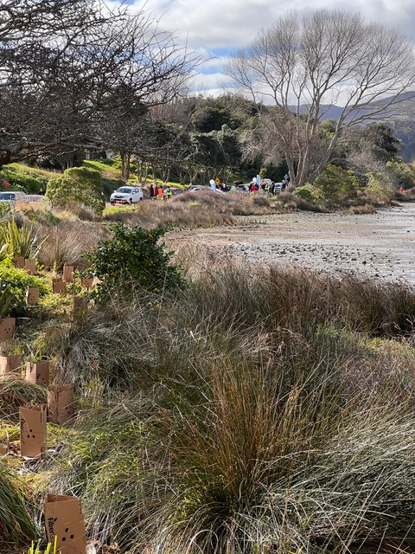
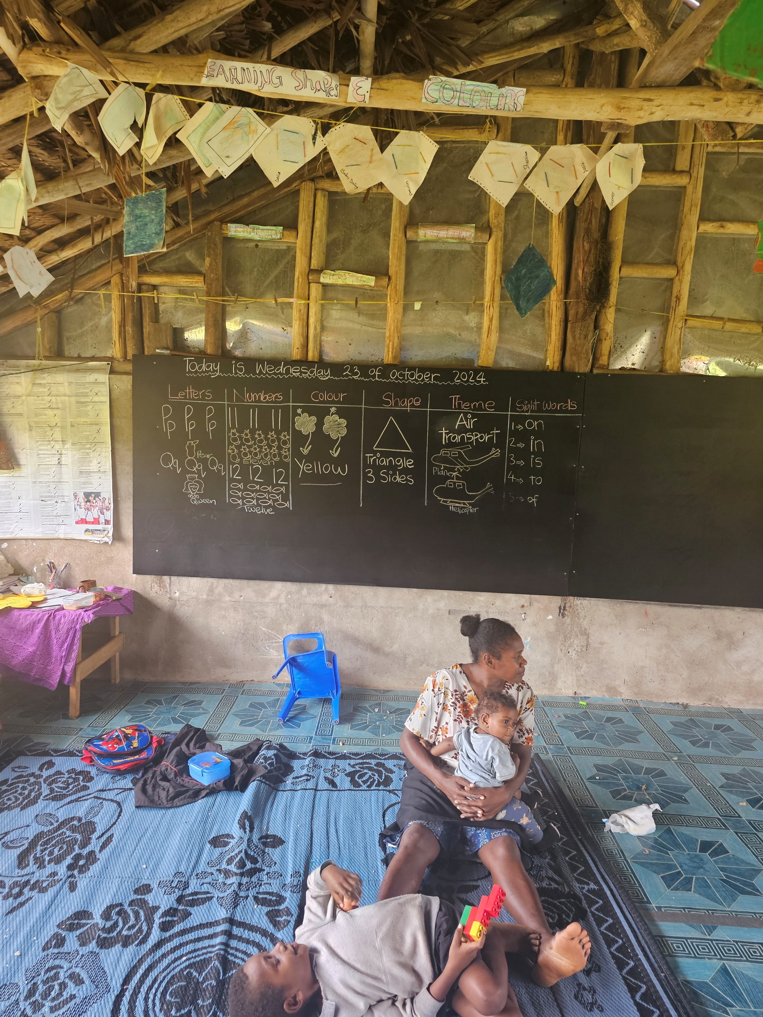
Water for Rongdal School Vanuatu
Foreshore planting Motukaraka Point

Slide 12
GLOBAL GRANTS
Large, long-term projects
Sustainable, measurable outcomes
Aligned with the Foundation’s mission
International partnership
World Fund Match 80%

Slide 13

Contact: Irina Francken
Global grants fund larger projects with budgets of US$30,000 or more. We encourage your club or community group to consider these grants for your projects.
Please discuss your Global Grant idea with Irina before you start.
With her expertise in this area Irina can
assist you through the process
irina@globaladdress.com

Slide 14

Global Grants for 2025-2026-2027
REPORTED progress:
1. GG2128455 Tongan Orthopaedic Surgical Upgrade D9940
APROVED 2026
2. GG2581153 Nalauwaki Village School, Waya Island, Fiji (Toilets, Fit Out, Water, Solar, Fencing) Ed and WASH
3. GG2461599 Siem Reap Rural Schools WASH Project

Slide 15
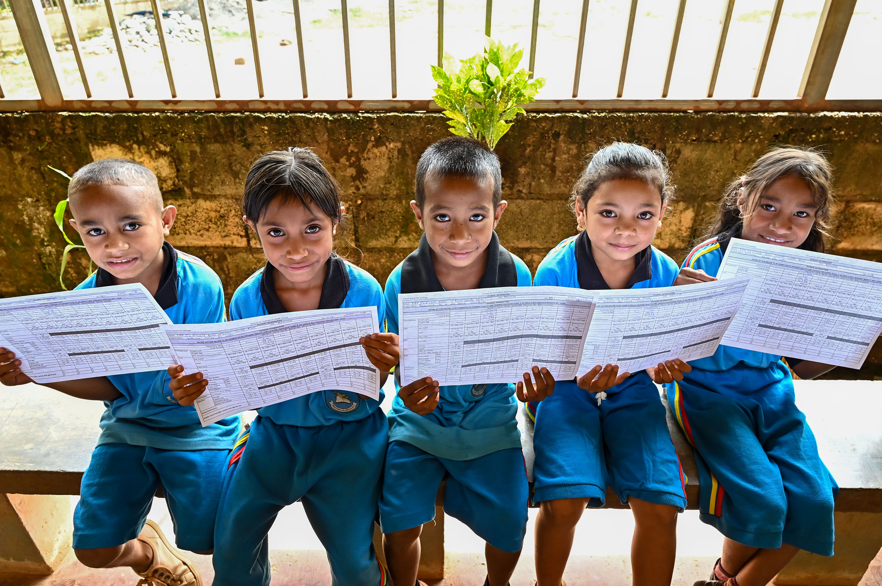

Global Grants for 2025-2026-2027
SUBMITTED 2026
4. GG2690653 Early Childhood Education in Timor-Leste (stage I) D9940
DRAFT 2026
5. GG2692768 Lifting the Lid D9940

Slide 16
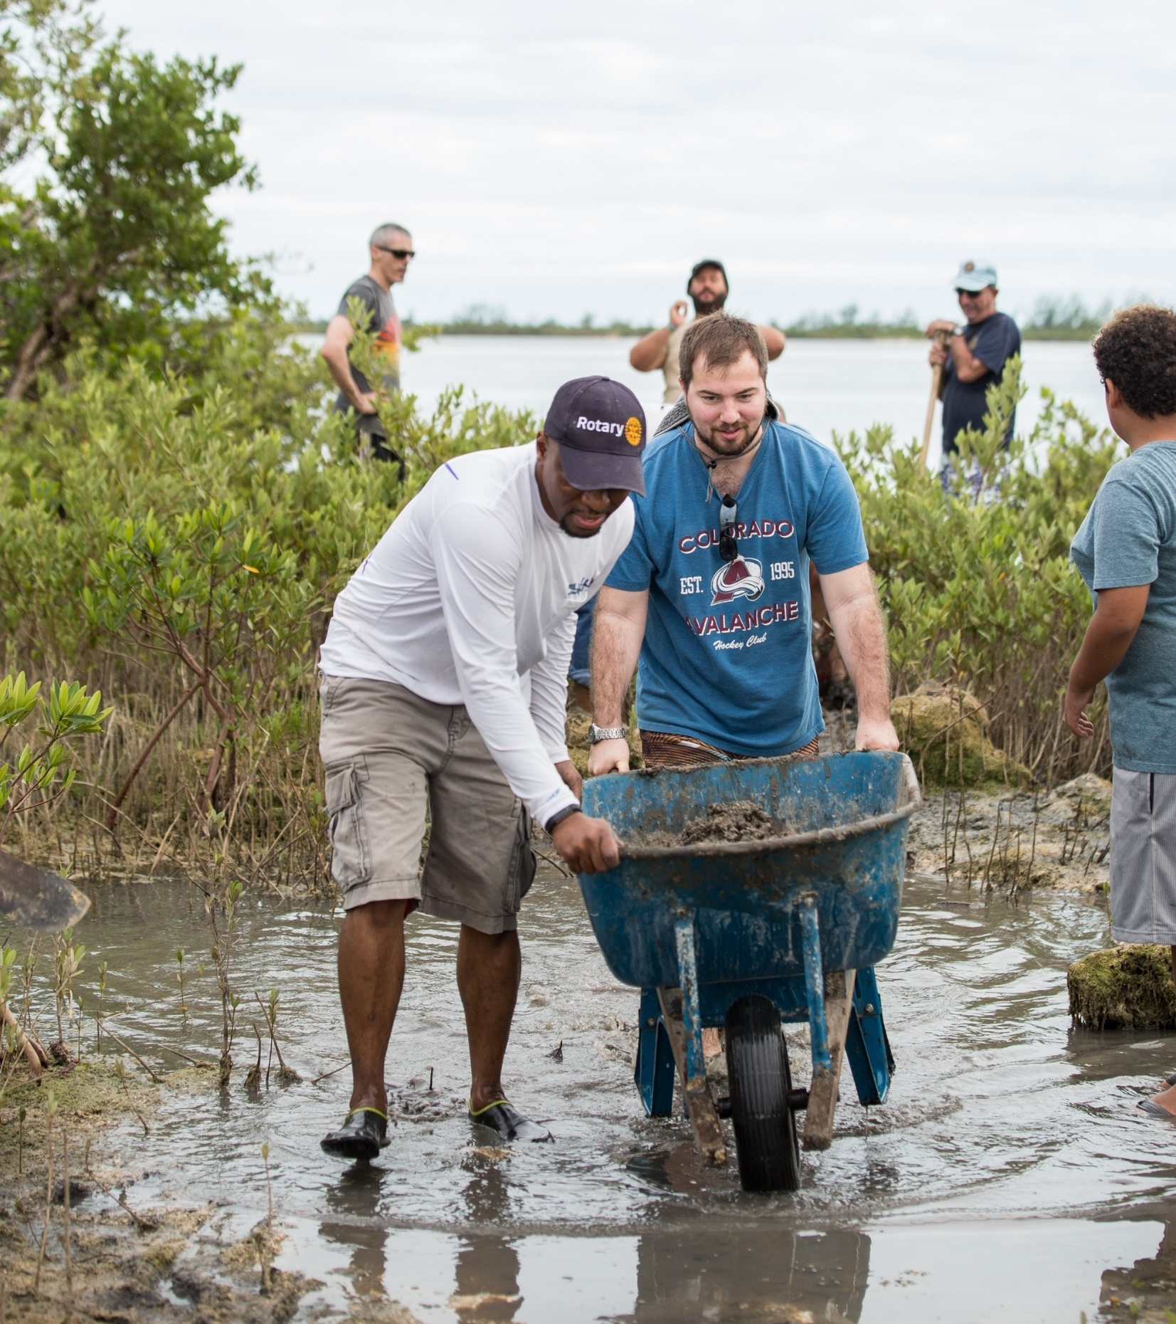
subhead
Disaster response GRANTS
Support relief and recovery efforts in areas affected by natural disaster
Funded by contributions to the Rotary Disaster Response Fund

Slide 17
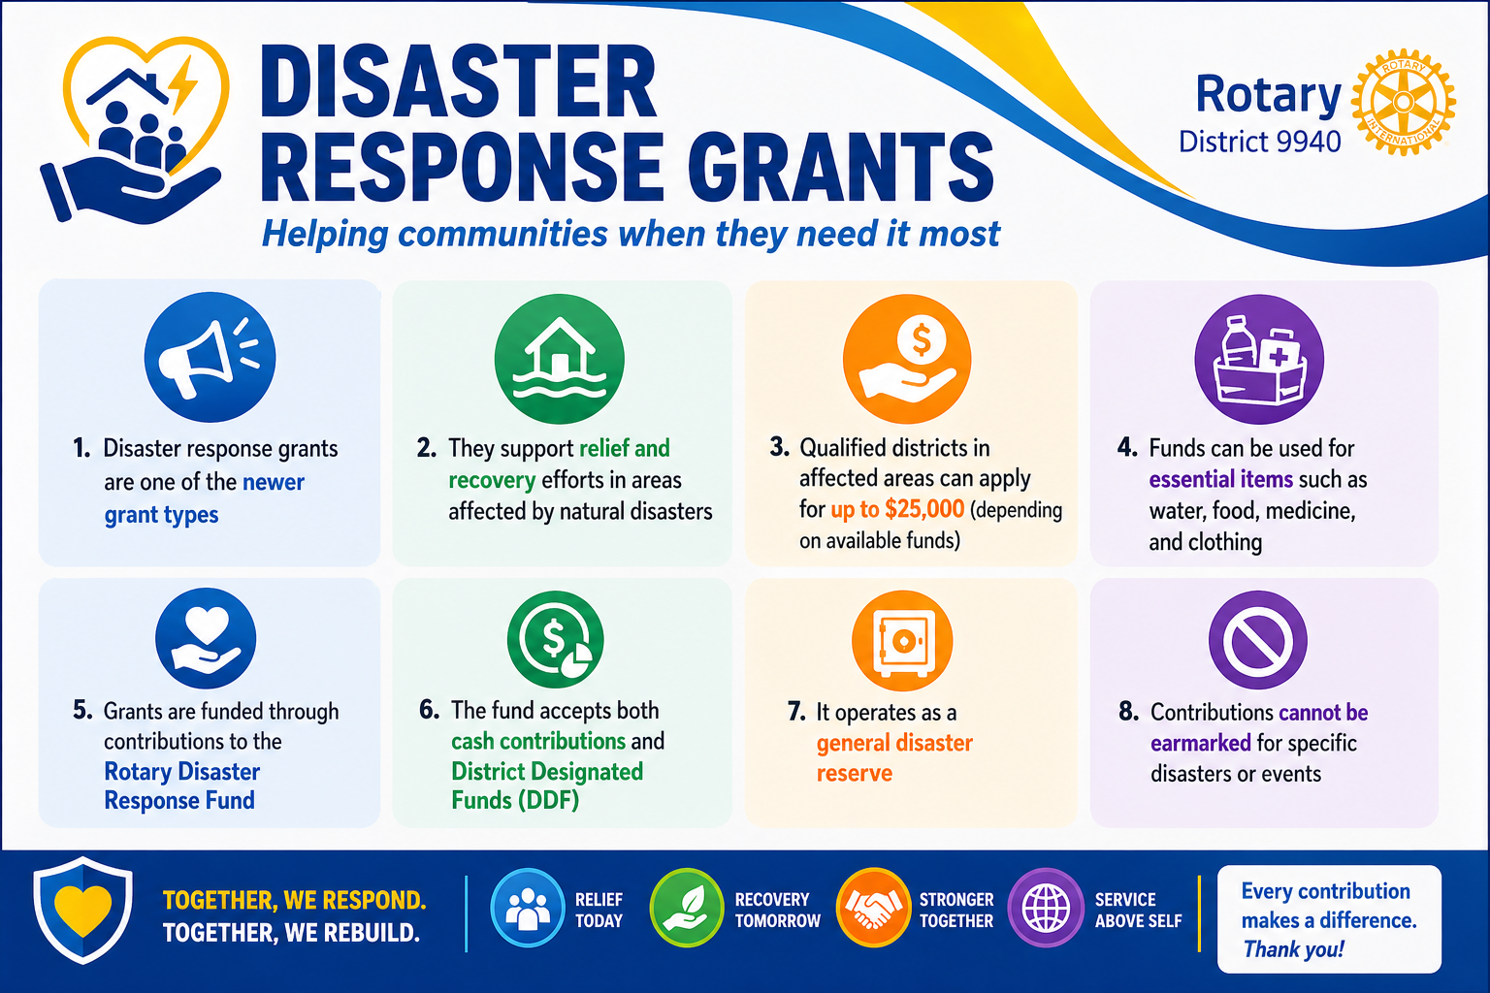

Slide 18
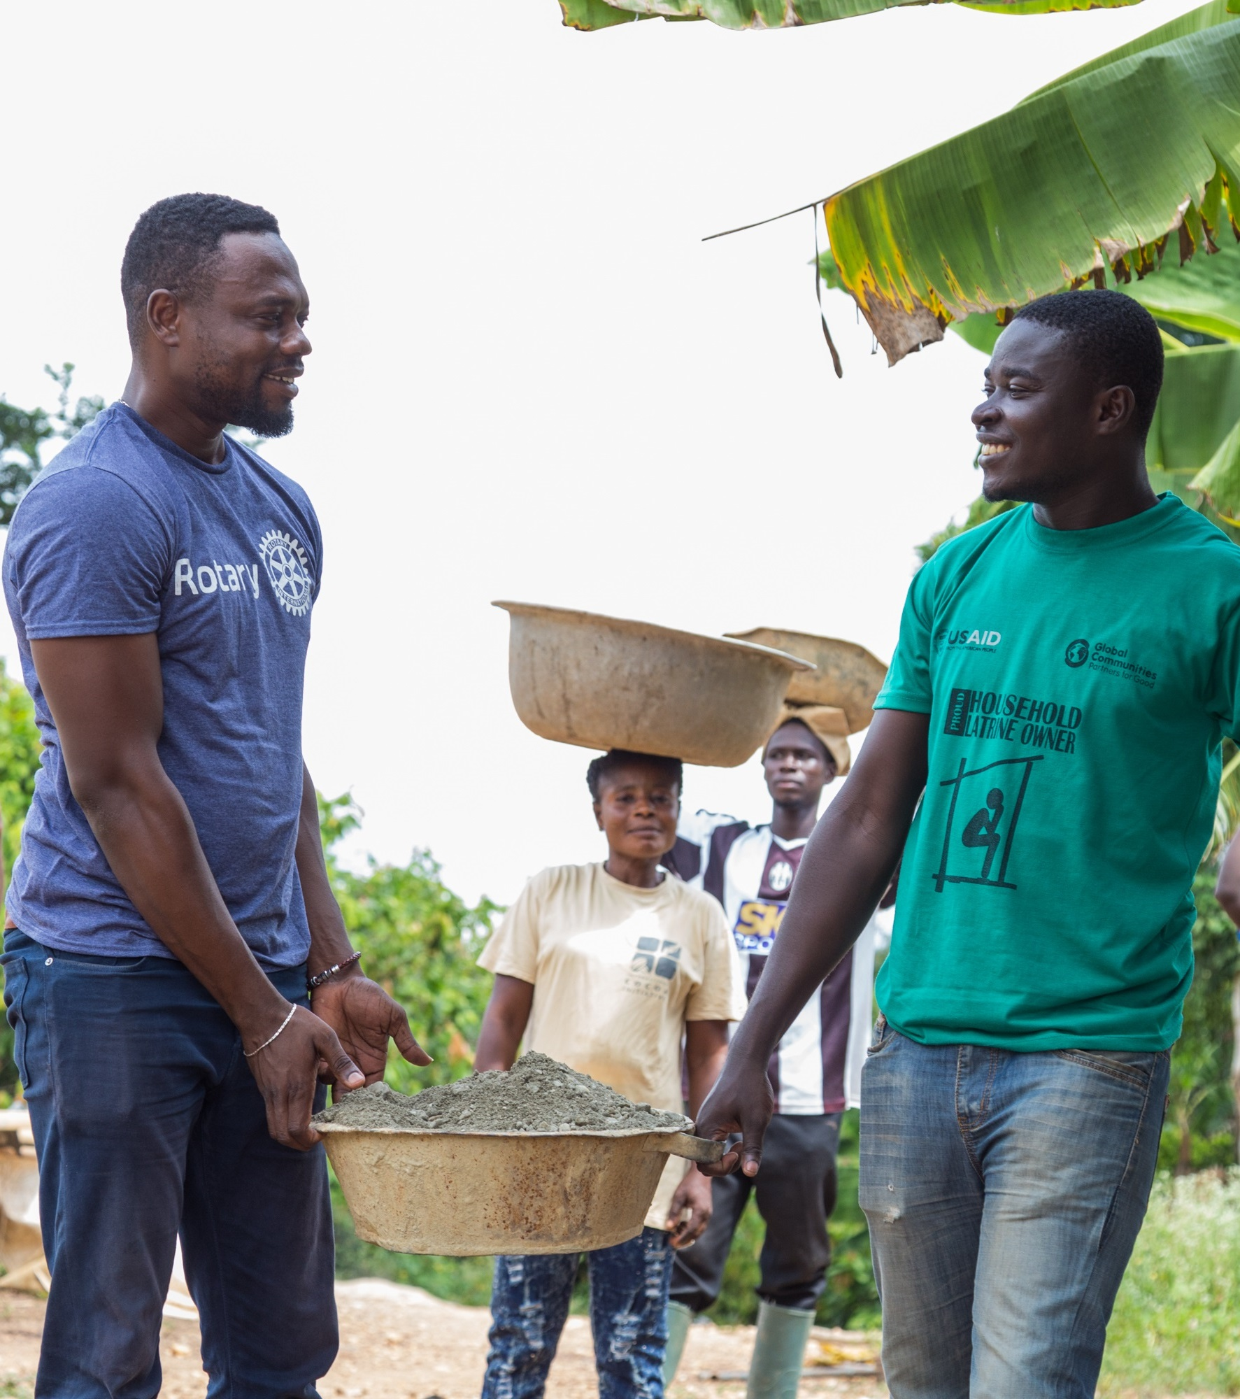
subhead
Programs of scale GRANTS
Long-term activities that benefit large number of people
Alignment with areas of focus
World Fund award of $2 million; no additional Rotarian funding required
Implemented with partner organization(s)
Competitive two-step application process

Slide 19
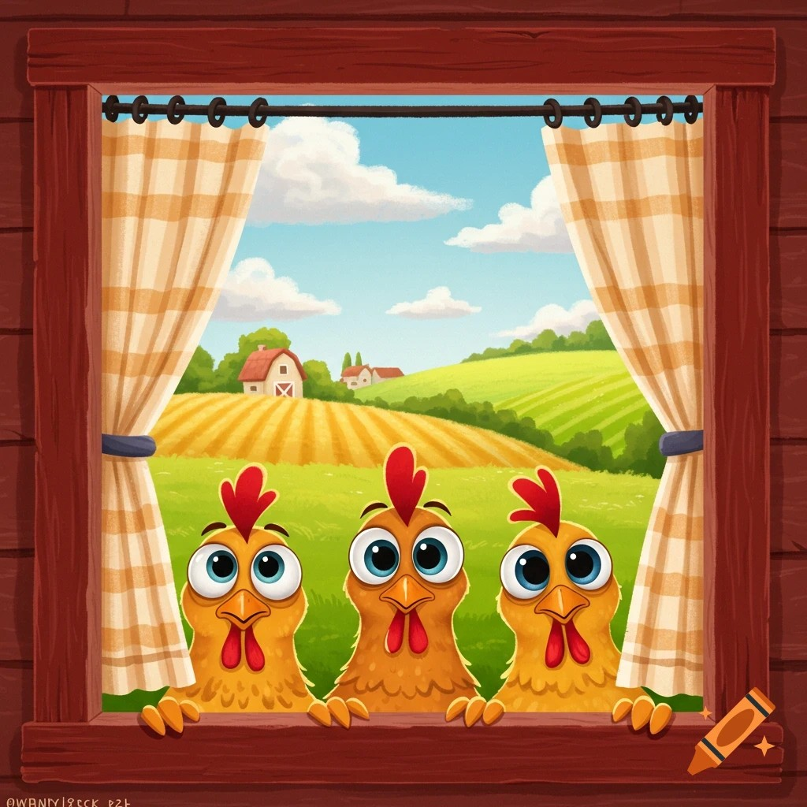

Slide 20







Fundraising Goals for 2026-2027
Supporting the Rotary Foundation
Centurion Program
Paul Harris Fellow
100% of Club members to contribute on an annual basis.
Contribute ^{US}$1,000 and recognise a member of your local community
Paul Harris Society
Ending Polio
Every Club to encourage at least one member to commit to this level of support
Commit the Club to contributing ^{US}$1,500 annually.
Annual Fund Contribution
Bequest Society
Commit 15% of total fundraising to annual fund and become a Club Major Donor
Make members aware that they can leave a bequest in their will to keep doing good in the world , forever

Slide 21
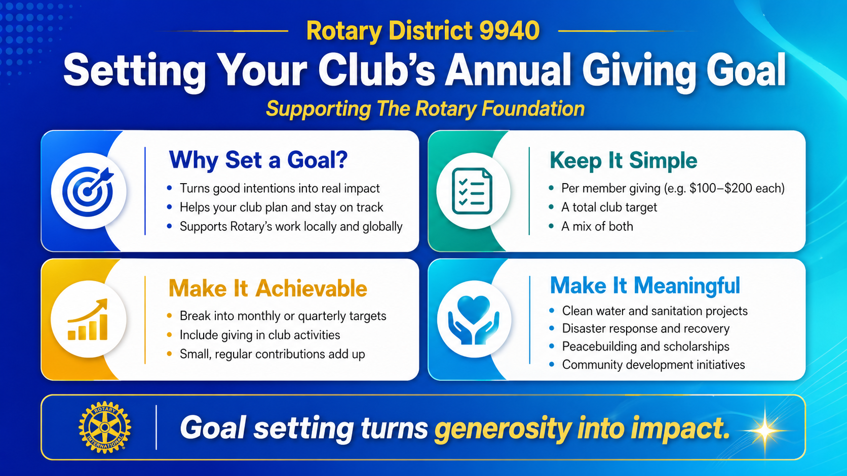

Slide 22
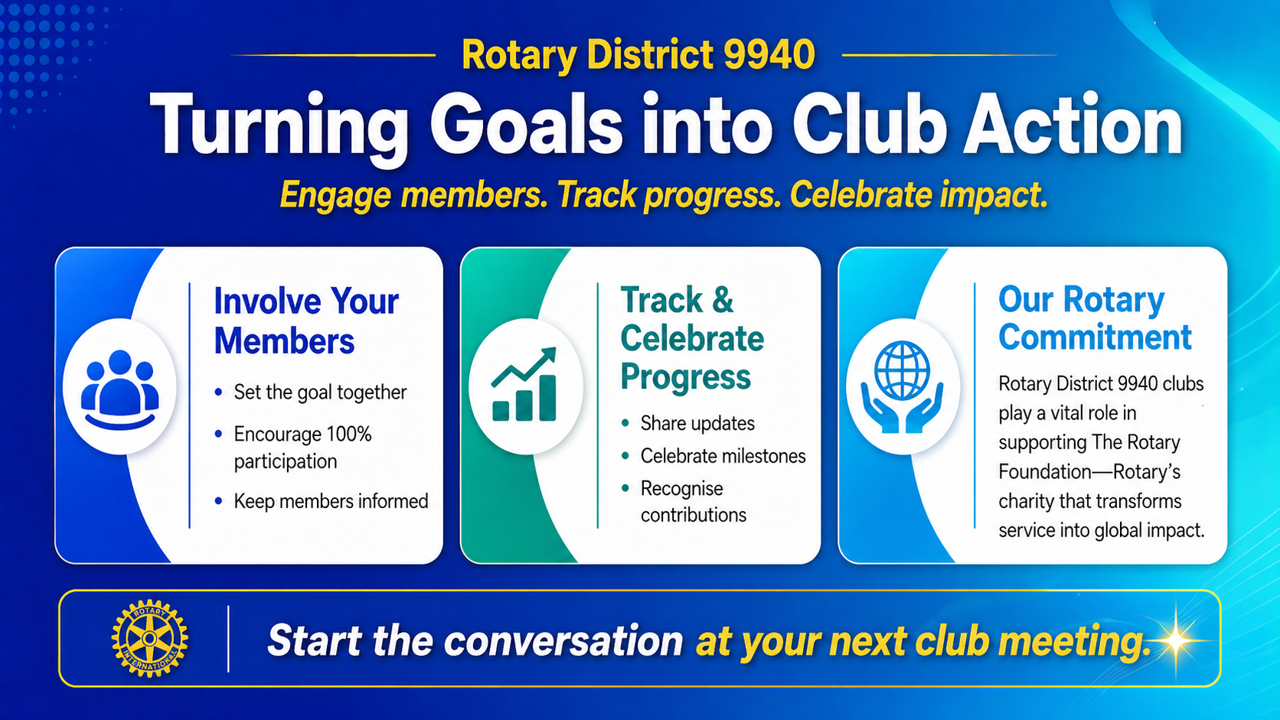

Slide 23








Rotary and Rotary Foundation Project Partners
Partnerships with global organisations to amplify service projects.
Shelterbox
Provides emergency shelter and supplies to assist survivors immediately after a disaster.
ASK
Habit for Humanity
Works with families and individuals in need, helping them build or improve homes.
World Health Organisation
Humanitarian Projects at both a local and international level
Gates Foundation
Fundraising linked to Annual Fund, Endowment Fund, End Polio Fund and Disaster Fund
Unicef
Works with Rotary to deliver Polio Vaccines and Humanitarian Service Projects
Toastmasters
Helps its members become more effective public speakers, communicators, and leaders.

Slide 24




The brand reputation
How much of your Club time is devoted to fundraising?
How much of the funds raised by your Club go to Rotary Branded programs projects?
and

Slide 25





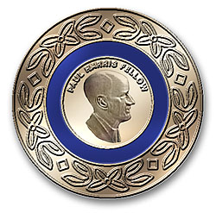

The Rotary Foundation Programs
Examples of Rotary Foundation recognised Programs
END POLIO NOW
Ending Polio, the number one priority of The Rotary Foundation and Rotary International
ASK
Rotary Peace Centres
Scholarship Program linked to partner universities around the world
Rotary Foundation Global and District Grants
Humanitarian Projects at both a local and international level
Fundraising
Fundraising linked to Annual Fund, Endowment Fund, End Polio Fund and Disaster Fund
Polio Plus Society
Annual contribution of $100 to support ending Polio
Donor Recognition
Recognition programs, like Paul Harris Fellow, Paul Harris Society, Major Donor, Bequest Society, Arch Klumph Society, Legacy Society

Slide 26


Slide 27

Contact: Richard Wishnowsky
The Rotary Paul Harris Society (PHS) is a specialized district-level program that recognizes Rotarians and friends of The Rotary Foundation who commit to contributing $1000 USD or more annually to the Annual Fund, PolioPlus Fund, or approved global grants.
It fosters sustainable, long-term international projects and local community service

Slide 28

Contact:
DGE Chris Eales or
Peter Whittington
Foundation fundraising involves soliciting grants, donations, or partnerships from philanthropic entities (private, family, or community foundations) to fund nonprofit projects and operational costs.
It focuses on aligning a nonprofit's mission with a foundation’s specific giving priorities to secure sustainable funding and achieve community impact.
Every dollar donated helps make change in the world

Slide 29

Peace and Rotary
Contact: David Seifert

Slide 30


Slide 31
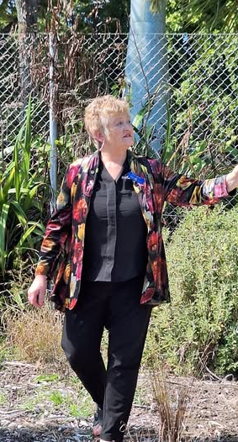
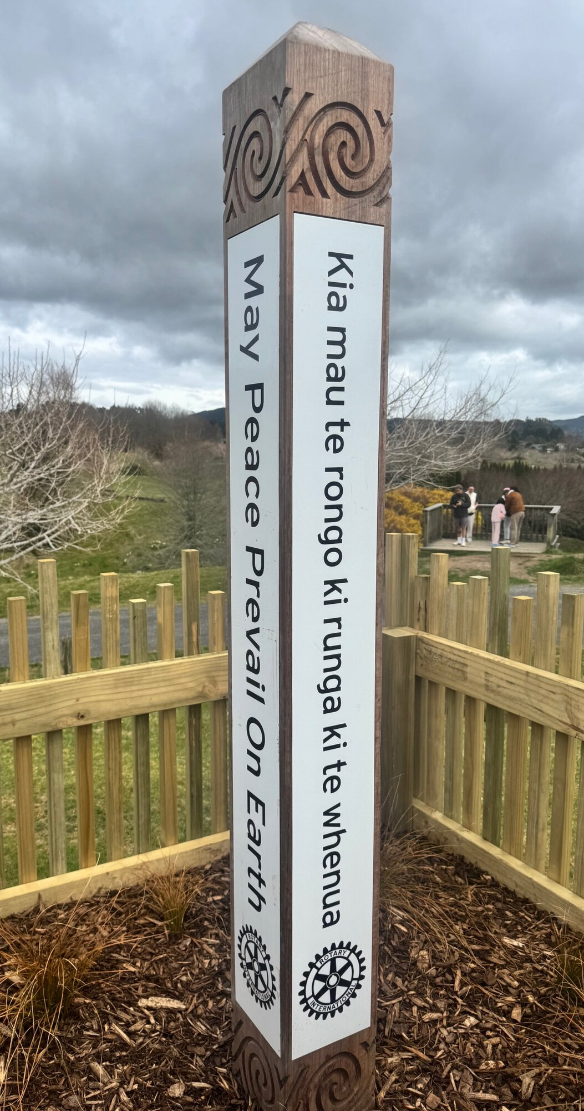
A Rotary Peace Pole is a monument displaying
"May Peace Prevail on Earth" in multiple languages,
serving as an internationally recognized symbol of hope,
unity, and the organization's commitment to peace.
Often installed in public places like parks or schools,
they act as focal points for community reflection,
frequently unveiled with ceremonies to promote harmony.

Slide 32
Rotary Action Group for Peace
Peacebuilder clubs:
Sponsor at least two peacebuilder activities per year
(eg, peace poles and peace parks/gardens)
Nominate applicants to become Peace Fellows
Provide financial support for Peace Centres
Keep in touch with graduates
Strengthen the ability to influence positive change
Peacebuilder Districts mirror peacebuilder clubs

Slide 33

Rotary Action Group for Peace
What if we saw Rotary not just as a network of service clubs, but as a global movement for peace?
Together, we can create a world built on dialogue, collaboration and understanding.
PEACE IS POSSIBLE

Slide 34

The Rotary Foundation
The Rotarian’s Charity of Choice
Goodness is part and parcel of what is we do as Rotarians

