Slide 1


Welcome to District Assembly

Slide 2

Barbara Mifsud – Regional Membership Officer
Carol Green – District Governor
Chris Eales – District Governor Nominee
Adrian Gregory – District Executive Secretary
Graham Evans - Treasurer
Linda Wellington – Incoming Treasurer
Jocelyn Hogg –Past District Governor / Co-Chair Rotary Foundation
Anthony Scott – Past District Governor / Council on Chambers Representative
Irina Francken – The Rotary Foundation Co-Chair
Wayne Gordon – Past District Governor
Helen Algar – District Finance and Risk Committee Chair
John Prendergast – District Learning and Development Lead

Slide 3
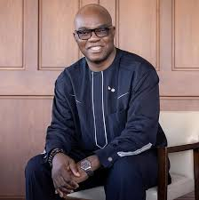
Meet your Rotary International President 2026-2027
Olayinka Hakeem Babalola
‘Yinka’

Slide 4


Slide 5


Slide 6
Rotary Oceania Medical Aid for Children
Interplast
ShelterBox
Rotary New Zealand World Community Services (RNZWCS) /
Rotary Australia World Community Services (RAWCS)
Rotary Oceania Zone Operations (ROZOPs)

